Slide 1
Update on Tobacco Control
Steven A. Schroeder, MD
Global Oral Health Symposium, 2013
Presentation courtesy of
The Smoking Cessation Leadership Center
and Rx for Change

Slide 2
Topics for Today
Facts about smoking and health
Tobacco use epidemiology
Tobacco control policies
Conclusion and next steps

Slide 3
Facts About Smoking and Health

Slide 4
Tobacco’s Deadly Toll
443,000 deaths in the U.S. each year
4.8 million deaths world wide each year
10 million deaths estimated by year 2030
50,000 deaths in the U.S. due to second-hand smoke exposure
8.6 million disabled from tobacco in the U.S. alone
45.3 million smokers in U.S. (78% daily smokers, averaging 13 cigarettes/day, 2010)

Slide 5
Tobacco: Leading Preventable Cause of Death
Annual Deaths in 2000
Notes:
Tobacco leading cause of preventable death
1.3 billion smokers globally
4.9 million die/year (1:10)
10 million/year by 2020 (1:6)

Slide 6
Annual U.S. Deaths Attributable to Smoking, 2000–2004
Percent of all smoking-attributable deaths
Cardiovascular diseases | 128,497
Lung cancer | 125,522
Respiratory diseases | 103,338
Second-hand smoke | 49,400
Cancers other than lung | 35,326
Other | 1,512
29%
28%
23%
11%
8%
<1%
TOTAL: 443,595 deaths annually
Centers for Disease Control and Prevention. MMWR 2008;571226–1228.
Notes:
Cigarette smoking is the primary known preventable cause of premature death in the U.S. Each year, nearly half a million Americans die from cigarette smoking; one of every five deaths in the U.S. is smoking related (CDC, 2008). This number surpasses the combined death toll due to alcohol, car accidents, suicides, homicides, HIV disease, and illicit drug use.
Average number of years of life lost because of smoking, for male and female smokers (CDC, 2002):
Males 13.2 years
Females 14.5 years
A total of 443,595 annual deaths due to cigarette smoking are reported by the CDC (2008) as follows:
Cardiovascular disease………… 128,497
Ischemic heart disease, other heart diseases, cerebrovascular diseases, atherosclerosis, aortic aneurysm, other circulatory diseases
Lung cancer………………………125,522
Trachea, lung, bronchus (not including lung cancer due to second-hand smoke exposure)
Respiratory diseases…………….103,338
Pneumonia, influenza, bronchitis, emphysema, chronic airway obstruction
Second-hand smoke……………....49,400
Cancers other than lung…………..35,326
Lip, oral cavity, pharynx, esophagus, pancreas, larynx, cervix, uterus, urinary bladder, kidney, other urinary
Other………………………………….1,512
Centers for Disease Control and Prevention. Annual smoking-attributable mortality, years of potential life lost, and productivity losses—United States, 2000–2004. MMWR 2008;57:1126–1128.
Slide is used with permission, Rx for Change: Clinician-Assisted Tobacco Cessation. Copyright © 1999-2009 The Regents of the University of California. All rights reserved.

Slide 7
Health Consequences of Smoking
Cancers
Acute myeloid leukemia
Bladder and kidney
Cervical
Esophageal
Gastric
Laryngeal
Lung
Oral cavity and pharyngeal
Pancreatic
Prostate (↑incidence and ↓survival)
Pulmonary diseases
Acute (e.g., pneumonia)
Chronic (e.g., COPD)
Cardiovascular diseases
Abdominal aortic aneurysm
Coronary heart disease
Cerebro-vascular disease
Peripheral arterial disease
Type 2 diabetes mellitus
Reproductive effects
Reduced fertility in women
Poor pregnancy outcomes (e.g., low birth weight, preterm delivery)
Infant mortality; childhood obesity
Other effects: cataract, osteoporosis, periodontitis, poor surgical outcomes, Alzheimers; rheumatoid arthritis; less sleep
U.S. Department of Health and Human Services.
The Health Consequences of Smoking: A Report of the Surgeon General, 2010.
Notes:
The 2004 Surgeon General’s Report on the health consequences of smoking describes a long list of diseases with sufficient evidence to infer a causal relationship with smoking.
♪ Note to instructor(s): For more detailed information and literature citations regarding risks for these tobacco-related illnesses, refer to the Pathophysiology of Tobacco-Related Disease module or the Surgeon General’s Report at http://www.surgeongeneral.gov/library/smokingconsequences.
U.S. Department of Health and Human Services. The Health Consequences of Smoking: A Report of the Surgeon General. U.S. Department of Health and Human Services, Centers for Disease Control and Prevention, National Center for Chronic Disease Prevention and Health Promotion, Office on Smoking and Health, 2004. Available at http://www.surgeongeneral.gov/library/smokingconsequences. Accessed May 29, 2004.
Slide is used with permission, Rx for Change: Clinician-Assisted Tobacco Cessation. Copyright © 1999-2009 The Regents of the University of California. All rights reserved.

Slide 8
Never Too Late to Quit*
Age of quitting smoking Years of life saved
25-34 10
35-44 9
45-54 8
55-64 4
* Jha, NEJM Jan 24, 2013

Slide 9
Smoking and Mental Illness: The Heavy Burden
200,000 annual deaths from smoking occur among patients with CMI and/or substance abuse
This population consumes 40% of all cigarettes sold in the United States
-- higher prevalence
-- smoke more
-- more likely to smoke down to the butt
People with CMI die earlier than others, and smoking is a large contributor to that early mortality
Social isolation from smoking compounds the social stigma

Slide 10
Causal Associations with Second-hand Smoke
There is no safe level of second-hand smoke.
Developmental
Low birthweight
Sudden infant death syndrome (SIDS)
Pre-term delivery
-- Childhood depression
Respiratory
Asthma induction and exacerbation
Eye and nasal irritation
Bronchitis, pneumonia, otitis media, bruxism in children
Decreased hearing in teens
Carcinogenic
Lung cancer
Nasal sinus cancer
Breast cancer (younger, premenopausal women)
Cardiovascular
Heart disease mortality
Acute and chronic coronary heart disease morbidity
Altered vascular properties
USDHHS. (2006). The Health Consequences of Involuntary Exposure to Tobacco Smoke: Report of the Surgeon General.

Slide 11
Epidemiology of Tobacco Use

Slide 12
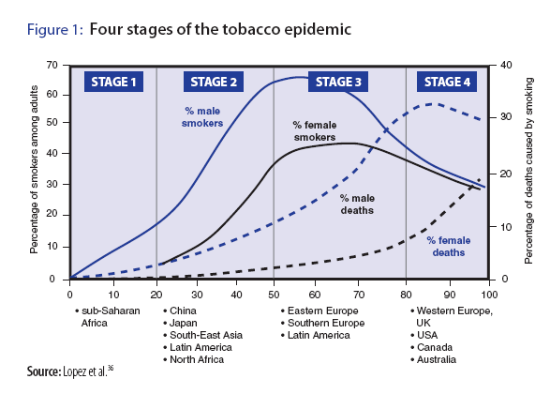
Why invest in Africa now?
Why invest in Africa now?
Opportunity Map
Four Stages of the Tobacco Epidemic
This slide shows the tobacco epidemic over an entire century.
Tobacco control efforts generally start in the late stages of the epidemic, but we have an opportunity to stop the epidemic from occurring in Africa by starting now, while it is still in Stage 1.
© 2009 Bill & Melinda Gates Foundation | 12
Notes:
12
Africa is the last place on earth for the tobacco-epidemic to occur (other than women in various locations). It we don’t work on stopping the epidemic before it starts, we will have a century of misery, an unprecedented double burden of disease (because of the high rates of infectious diseases), etc. This is a unique opportunity, and if we move fast in Africa we have a chance for significant catalytic change.

Slide 13
TRENDS in ADULT SMOKING, by SEX—U.S., 1955–2011
Trends in cigarette current smoking among persons aged 18 or older
19% of adults are current smokers
Male
Percent
Female
21.0%
17.8%
Year
70% want to quit
Graph provided by the Centers for Disease Control and Prevention. 1955 Current Population Survey; 1965–2010 NHIS. Estimates since 1992 include some-day smoking.
Notes:
13
This graph demonstrates trends in smoking among adults in the U.S. between 1955 and 2007 (CDC, 1999, 2008). Since 1990, the smoking prevalence among men and women has experienced only a slight decline, compared to previous decades, highlighting a need for enhanced tobacco control efforts. In 2007, results of the National Health Interview Survey (NHIS) indicated that approximately 43.4 million adults (19.8% of the U.S. adult population) are current smokers¹ (CDC, 2008). Of these, 77.8% smoke every day and 22.2% smoke some days (CDC, 2008). A greater proportion of men (22.3%) than women (17.4%) are current smokers.
An estimated 70% of all smokers want to quit completely (CDC, 2002). In 2007, approximately 13.4 million (39.8%) of current smokers stopped smoking at least 1 day during the past 12 months because they were trying to quit (CDC, 2008). In 2007, an estimated 47.3 million adults were former smokers,² representing 52.1% of persons who had ever smoked (CDC, 2008).
♪ Note to instructor(s): Cessation statistics vary depending on factors such as the duration of follow-up, definitions of abstinence, and whether reports of cessation were biologically confirmed. According to the CDC (2002), 4.7% of smokers who had smoked every day or some days during the past year had quit and were able to maintain abstinence for 3–12 months in 2000.
¹Current smokers: persons who reported having smoked 100 or more cigarettes during their lifetime and who smoked every day or some days at the time of the interview.
²Former smokers: persons who reported having smoked 100 or more cigarettes during their lifetime but currently did not smoke.
Centers for Disease Control and Prevention (CDC). (1999). Achievements in public health, 1900–1999: Tobacco use—United States, 1900–1999. MMWR 48:986–993.
Centers for Disease Control and Prevention. (2002). Cigarette smoking among adults—United States, 2000. MMWR 51:642–645.
Centers for Disease Control and Prevention. (2008). Tobacco use among adults—United States, 2007. MMWR 57:1221–1226.
Slide is used with permission, Rx for Change: Clinician-Assisted Tobacco Cessation. Copyright © 1999-2009 The Regents of the University of California. All rights reserved.

Slide 14
Smoking Prevalence and Average Number of Cigarettes Smoked per Day per Current Smoker 1965-2010
Percent/Number of Cigarettes Smoked Daily
Source: Centers for Disease Control and Prevention (1965-2010). NHIS

Slide 16
Past Month Use of Cigarettes and Marijuana among US 12th Grade Students, 1975-2012

Slide 17
PREVALENCE of ADULT SMOKING, by RACE/ETHNICITY—U.S., 2011
31.5% American Indian/Alaska Native*
20.6% White*
19.4% Black*
12.9% Hispanic
9.9% Asian*
* non-Hispanic.
Centers for Disease Control and Prevention. (2012). MMWR 61(44);889-894.
Notes:
In 2005, the prevalence of smoking in the U.S. was highest among American Indian/Alaska Natives (32.0%) and next highest among non-Hispanic Whites (21.9%), followed by non-Hispanic Blacks (21.5%), Hispanics (16.2%), and Asians (13.3%) (CDC, 2006).
Centers for Disease Control and Prevention. (2006). Tobacco use among adults—United States, 2005. MMWR 55:1145–1148.
Slide is used with permission, Rx for Change: Clinician-Assisted Tobacco Cessation. Copyright © 1999-2009 The Regents of the University of California. All rights reserved.

Slide 18
PREVALENCE of ADULT SMOKING, by EDUCATION—U.S., 2011
25.1% No high school diploma
45.3% GED diploma
23.8% High school graduate
22.3% Some college
9.3% Undergraduate degree
5.0% Graduate degree
Centers for Disease Control and Prevention. (2012). MMWR 61(44);889-894.
Notes:
In 2005, the prevalence of current smoking¹ in the U.S. was highest among adults (aged 25 years or older) who had received a General Educational Development (GED) diploma (43.2%). Persons with a graduate degree (masters, professional, or doctorate) had the lowest prevalence (7.1%) (CDC, 2006).
Also notable is the fact that the prevalence of adult smoking is associated with poverty level. The prevalence is 20.6% for persons who are at or above the poverty level and 29.9% for persons who are below the poverty level (CDC, 2006).
The smoking prevalence is 24.4% for persons aged 18–24; 24.1% for persons aged 25–44; 21.9% for persons aged 45–64; and 8.6% for persons at least 65 years of age (CDC, 2006).
¹Current smokers: persons who reported having smoked 100 or more cigarettes during their lifetime and who smoked every day or some days at the time of the interview.
Centers for Disease Control and Prevention. (2006). Tobacco use among adults—United States, 2005. MMWR 55:1145–1148.
Slide is used with permission, Rx for Change: Clinician-Assisted Tobacco Cessation. Copyright © 1999-2009 The Regents of the University of California. All rights reserved.

Slide 19
PREVALENCE of SMOKING, by AGE GROUP—U.S., 2011
25.1%, 18 – 24 yrs
45.3%, 25 – 44 yrs
23.8%, 45 – 64yrs
22.3%, ≥ 65 yrs
Centers for Disease Control and Prevention. (2012). MMWR 61(44);889-894.
Notes:
In 2005, the prevalence of current smoking¹ in the U.S. was highest among adults (aged 25 years or older) who had received a General Educational Development (GED) diploma (43.2%). Persons with a graduate degree (masters, professional, or doctorate) had the lowest prevalence (7.1%) (CDC, 2006).
Also notable is the fact that the prevalence of adult smoking is associated with poverty level. The prevalence is 20.6% for persons who are at or above the poverty level and 29.9% for persons who are below the poverty level (CDC, 2006).
The smoking prevalence is 24.4% for persons aged 18–24; 24.1% for persons aged 25–44; 21.9% for persons aged 45–64; and 8.6% for persons at least 65 years of age (CDC, 2006).
¹Current smokers: persons who reported having smoked 100 or more cigarettes during their lifetime and who smoked every day or some days at the time of the interview.
Centers for Disease Control and Prevention. (2006). Tobacco use among adults—United States, 2005. MMWR 55:1145–1148.
Slide is used with permission, Rx for Change: Clinician-Assisted Tobacco Cessation. Copyright © 1999-2009 The Regents of the University of California. All rights reserved.

Slide 20
Tobacco Control Policies

Slide 21
Health Professionals’ Smoking Rates, 2004 *
Primary Care Physicians - 1.7%
Emergency Physicians - 5.7%
Psychiatrists - 3.2%
RN’s - 13.2%
Dentists - 5.8%
Dental Hygienists - 5.4%
Pharmacists – 4.5%
* E. Tong et al, Nicotine & Tobacco Research (Nicotine and Tobacco Research, May 27, 2010)

Slide 22
Adult Smoking Prevalence and Cigarette Tax Rates
Source: Schroeder and Warner, NEJM , July 2010

Slide 23
Federal Tobacco Tax Per Pack of Cigarettes
1951—8 cents
1982—16 cents
1991—20 cents
1993—24 cents
2001—34 cents
2002—39 cents
2009—$1.01

Slide 24
Tobacco Industry is Outspending Prevention Efforts 23:1
State Tobacco
Revenue
(taxes and settlement
funds)
$25.6 billion
Federal
Cigarette
Tax Revenues
Tobacco Industry Marketing & Promotion
Spending (2008)
$10.5 billion
$15
billion
Smokeless
Total CDC-Recommended Spending Level
Cigarettes
State Tobacco Program Budgets
$0.5 billion
$3.7 billion
Campaign for Tobacco Free Kids, Federal Trade Commission, American Heart Association American Cancer Society, American Lung Association, SmokeLess States National Tobacco Policy Initiative

Slide 27
Number of Smokers = New Smokers + Old Smokers - Quitters

Slide 28
Number of Quitters = Number of Quit Attempts X % of Quitters
Clinician advice
Price
Counseling
Counter- Marketing
Clean indoor air
Medications

Slide 29
Family Smoking Prevention and Tobacco Control Act
Signed into law June 22, 2009
Gives FDA power to regulate tobacco industry
Imposes new warnings and labels on tobacco packaging and advertisements
Bans flavored cigarettes, limits advertising of tobacco products to minors
Tobacco companies seek FDA approval for new tobacco products
Supreme Court rejected appeal by tobacco industry on graphic warning labels (April 2013)

Slide 30
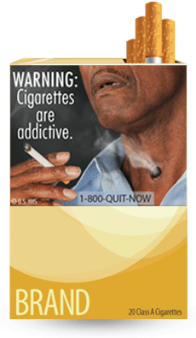
WARNING: Cigarettes are addictive.
Tobacco use can rapidly lead to the development of nicotine addiction, which in turn increases the frequency of tobacco use and prevents people from quitting. Research suggests that nicotine is as addictive as heroin, cocaine, or alcohol.

Slide 31
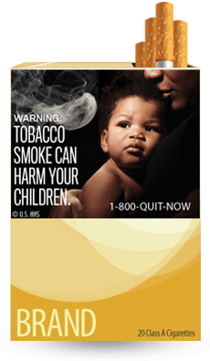
WARNING: Tobacco smoke can harm your children.
Secondhand smoke can cause serious health problems in children. Children who are exposed to secondhand smoke are inhaling many of the same cancer-causing substances and poisons as smokers.

Slide 32
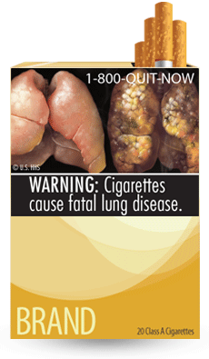
WARNING: Cigarettes cause fatal lung disease.
Smoking causes lung diseases such as emphysema, bronchitis, and chronic airway obstruction. About 90 percent of all deaths from chronic obstructive lung disease are caused by smoking.

Slide 33
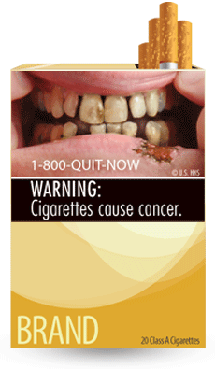
WARNING: Cigarettes cause cancer. Smoking causes approximately 90 percent of all lung cancer deaths in men and 80 percent of all lung cancer deaths in women. Smoking also causes cancers of the bladder, cervix, esophagus, kidney, larynx, lung, mouth, throat, stomach, uterus, and acute myeloid leukemia. Nearly one-third of all cancer deaths are directly linked to smoking.

Slide 34
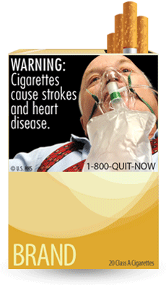
WARNING: Cigarettes cause strokes and heart disease.
More than 140,000 deaths from heart disease and stroke in the United States are caused each year by smoking and secondhand smoke exposure. Compared with nonsmokers, smoking is estimated to increase the risk of coronary heart disease and stroke by 2 to 4 times.

Slide 35
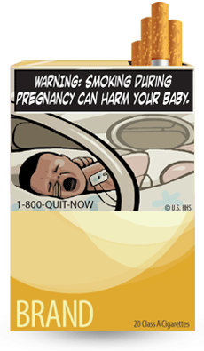
WARNING: Smoking during pregnancy can harm your baby.
Smoking during pregnancy can increase the risk of miscarriage, stillborn or premature infants, infants with low birth weight and an increased risk for sudden infant death syndrome (SIDS).

Slide 36
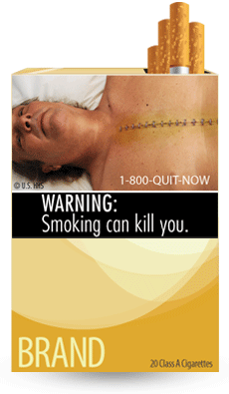
WARNING: Smoking can kill you. More than 1,200 people a day are killed by cigarettes in the United States alone, and 50 percent of all long-term smokers are killed by smoking-related diseases. Tobacco use is the cause of death for nearly one out of every five people in the United States, which adds up to about 443,000 deaths annually.

Slide 37
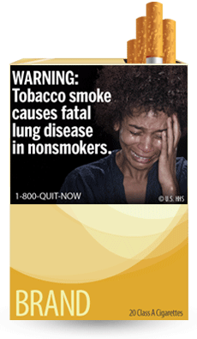
WARNING: Tobacco smoke causes fatal lung disease in nonsmokers. Nonsmokers who are exposed to secondhand smoke are inhaling many of the same cancer-causing substances and poisons as smokers. Nonsmokers who are exposed to secondhand smoke increase their risk of developing lung cancer by 20–30 percent.

Slide 38
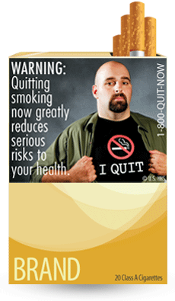
WARNING: Quitting smoking now greatly reduces serious risks to your health. Quitting at any age and at any time is beneficial. It's never too late to quit, but the sooner the better. Quitting gives your body a chance to heal the damage caused by smoking.

Slide 49
Conclusion and Next Steps

Slide 50
Tobacco Tipping Point?
California 11.9% adult smoking prevalence in 2010
National prevalence at modern low—19%!
Smokers smoke fewer cigarettes
Northern California Kaiser Permanente at 9%
Physician smoking prevalence at 1%
New FDA warning photos on cigarette packs now being revised

Slide 51
Tobacco Tipping Point (2)
Proliferation of smoke-free areas
Higher insurance premiums for smokers
April 2009 62 cent/pack federal tax increase
Lung cancer deaths in women start to fall
Increasing stigmatization of smoking
National mass media CDC TIPS campaign in 2012-2013, plus FDA warnings to come

Slide 52
Unresolved Issues
Treatment of light/intermittent smokers (>50% of smokers today)
Chronic use of cessation medications?
Risk of varenicline use?
Increased use of cigars and cigarillos
Best treatment for MI/SA population?
Better quitline marketing? Role of web-based systems?
Impact of state cuts in tobacco control programs (35%)
Implementation of FDA tobacco regulation
Refusal to hire smokers?
Third hand smoke
Menthol (ban?); (racial preferences; harder to quit)
How low can prevalence go?

Slide 53
Australian Health Minister
“We are killing people by not acting.”
Nicola Roxon, 2009

Slide 55
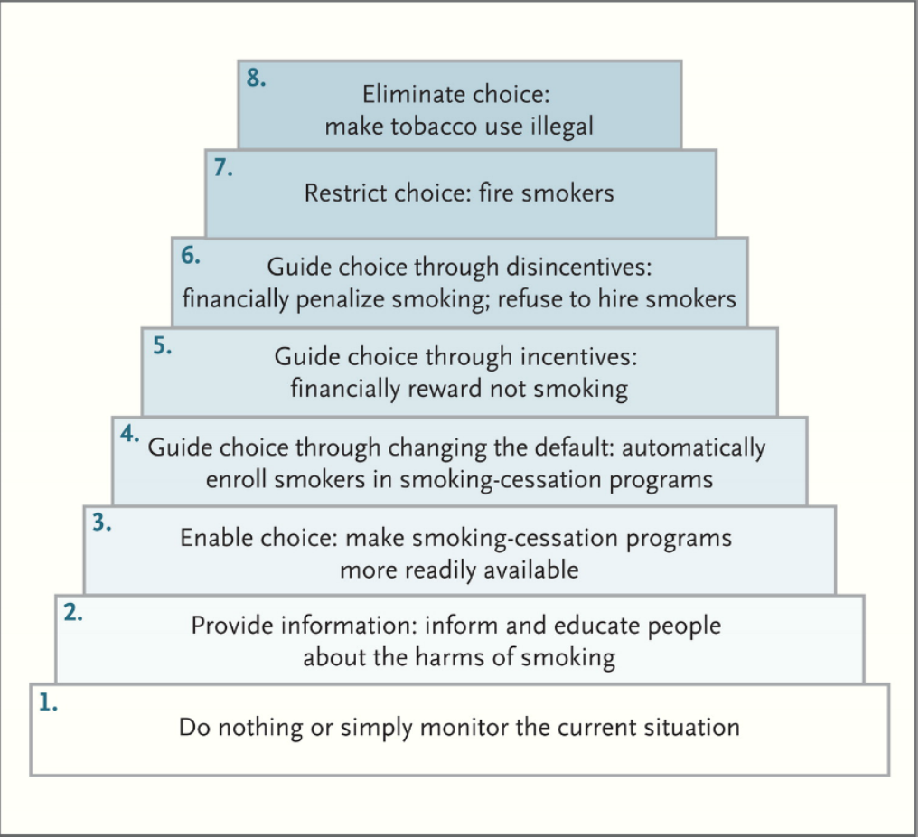
Proposed Ladder of Interventions to Reduce Tobacco Use
Source: Asch DA, et al. NEJM, April 11, 2013

