Slide 1
Why We Should Care About Smoking
Steven A. Schroeder, MD
Federal Occupational Health: Workplace Wellness Program, San Francisco, August 15,
The Smoking Cessation Leadership Center
and Rx for Change

Slide 4
Facts About Smoking and Health

Slide 5
Tobacco’s Deadly Toll
443,000 deaths in the U.S. each year
4.8 million deaths world wide each year
10 million deaths estimated by year 2030
50,000 deaths in the U.S. due to second-hand smoke exposure
8.6 million disabled from tobacco in the U.S. alone
45.3 million smokers in U.S. (78% daily smokers, averaging 15 cigarettes/day, 2010)

Slide 7
Annual U.S. Deaths Attributable to Smoking, 2000–2004
Percent of all smoking-attributable deaths
Cardiovascular diseases | 128,497
Lung cancer | 125,522
Respiratory diseases | 103,338
Second-hand smoke | 49,400
Cancers other than lung | 35,326
Other | 1,512
29%
28%
23%
11%
8%
<1%
TOTAL: 443,595 deaths annually
Centers for Disease Control and Prevention. MMWR 2008;571226–1228.
Notes:
Cigarette smoking is the primary known preventable cause of premature death in the U.S. Each year, nearly half a million Americans die from cigarette smoking; one of every five deaths in the U.S. is smoking related (CDC, 2008). This number surpasses the combined death toll due to alcohol, car accidents, suicides, homicides, HIV disease, and illicit drug use.
Average number of years of life lost because of smoking, for male and female smokers (CDC, 2002):
Males 13.2 years
Females 14.5 years
A total of 443,595 annual deaths due to cigarette smoking are reported by the CDC (2008) as follows:
Cardiovascular disease………… 128,497
Ischemic heart disease, other heart diseases, cerebrovascular diseases, atherosclerosis, aortic aneurysm, other circulatory diseases
Lung cancer………………………125,522
Trachea, lung, bronchus (not including lung cancer due to second-hand smoke exposure)
Respiratory diseases…………….103,338
Pneumonia, influenza, bronchitis, emphysema, chronic airway obstruction
Second-hand smoke……………....49,400
Cancers other than lung…………..35,326
Lip, oral cavity, pharynx, esophagus, pancreas, larynx, cervix, uterus, urinary bladder, kidney, other urinary
Other………………………………….1,512
Centers for Disease Control and Prevention. Annual smoking-attributable mortality, years of potential life lost, and productivity losses—United States, 2000–2004. MMWR 2008;57:1126–1128.
Slide is used with permission, Rx for Change: Clinician-Assisted Tobacco Cessation. Copyright © 1999-2009 The Regents of the University of California. All rights reserved.

Slide 8
Health Consequences of Smoking
Cancers
Acute myeloid leukemia
Bladder and kidney
Cervical
Esophageal
Gastric
Laryngeal
Lung
Oral cavity and pharyngeal
Pancreatic
Prostate (↑incidence and ↓survival)
Pulmonary diseases
Acute (e.g., pneumonia)
Chronic (e.g., COPD)
Cardiovascular diseases
Abdominal aortic aneurysm
Coronary heart disease
Cerebro-vascular disease
Peripheral arterial disease
Type 2 diabetes mellitus
Reproductive effects
Reduced fertility in women
Poor pregnancy outcomes (e.g., low birth weight, preterm delivery)
Infant mortality; childhood obesity
Other effects: cataract, osteoporosis, periodontitis, poor surgical outcomes, Alzheimers; rheumatoid arthritis
U.S. Department of Health and Human Services.
The Health Consequences of Smoking: A Report of the Surgeon General, 2010.
Notes:
The 2004 Surgeon General’s Report on the health consequences of smoking describes a long list of diseases with sufficient evidence to infer a causal relationship with smoking.
♪ Note to instructor(s): For more detailed information and literature citations regarding risks for these tobacco-related illnesses, refer to the Pathophysiology of Tobacco-Related Disease module or the Surgeon General’s Report at http://www.surgeongeneral.gov/library/smokingconsequences.
U.S. Department of Health and Human Services. The Health Consequences of Smoking: A Report of the Surgeon General. U.S. Department of Health and Human Services, Centers for Disease Control and Prevention, National Center for Chronic Disease Prevention and Health Promotion, Office on Smoking and Health, 2004. Available at http://www.surgeongeneral.gov/library/smokingconsequences. Accessed May 29, 2004.
Slide is used with permission, Rx for Change: Clinician-Assisted Tobacco Cessation. Copyright © 1999-2009 The Regents of the University of California. All rights reserved.

Slide 9
Epidemiology of Tobacco Use

Slide 10
TRENDS in ADULT SMOKING, by SEX—U.S., 1955–2010
Trends in cigarette current smoking among persons aged 18 or older
19.3% of adults are current smokers
Male
Percent
Female
21.0%
17.8%
Year
70% want to quit
Graph provided by the Centers for Disease Control and Prevention. 1955 Current Population Survey; 1965–2010 NHIS. Estimates since 1992 include some-day smoking.
Notes:
10
This graph demonstrates trends in smoking among adults in the U.S. between 1955 and 2007 (CDC, 1999, 2008). Since 1990, the smoking prevalence among men and women has experienced only a slight decline, compared to previous decades, highlighting a need for enhanced tobacco control efforts. In 2007, results of the National Health Interview Survey (NHIS) indicated that approximately 43.4 million adults (19.8% of the U.S. adult population) are current smokers¹ (CDC, 2008). Of these, 77.8% smoke every day and 22.2% smoke some days (CDC, 2008). A greater proportion of men (22.3%) than women (17.4%) are current smokers.
An estimated 70% of all smokers want to quit completely (CDC, 2002). In 2007, approximately 13.4 million (39.8%) of current smokers stopped smoking at least 1 day during the past 12 months because they were trying to quit (CDC, 2008). In 2007, an estimated 47.3 million adults were former smokers,² representing 52.1% of persons who had ever smoked (CDC, 2008).
♪ Note to instructor(s): Cessation statistics vary depending on factors such as the duration of follow-up, definitions of abstinence, and whether reports of cessation were biologically confirmed. According to the CDC (2002), 4.7% of smokers who had smoked every day or some days during the past year had quit and were able to maintain abstinence for 3–12 months in 2000.
¹Current smokers: persons who reported having smoked 100 or more cigarettes during their lifetime and who smoked every day or some days at the time of the interview.
²Former smokers: persons who reported having smoked 100 or more cigarettes during their lifetime but currently did not smoke.
Centers for Disease Control and Prevention (CDC). (1999). Achievements in public health, 1900–1999: Tobacco use—United States, 1900–1999. MMWR 48:986–993.
Centers for Disease Control and Prevention. (2002). Cigarette smoking among adults—United States, 2000. MMWR 51:642–645.
Centers for Disease Control and Prevention. (2008). Tobacco use among adults—United States, 2007. MMWR 57:1221–1226.
Slide is used with permission, Rx for Change: Clinician-Assisted Tobacco Cessation. Copyright © 1999-2009 The Regents of the University of California. All rights reserved.

Slide 11
Adult Smoking Prevalence U.S.A. 1955-2009
Source: Centers for Disease Control and Prevention (Schroeder and Warner, NEJM, July 2010)

Slide 12
Smoking Prevalence and Average Number of Cigarettes Smoked per Day per Current Smoker 1965-2010
Percent/Number of Cigarettes Smoked Daily
Source: Centers for Disease Control and Prevention (1965-2010). NHIS

Slide 13
PREVALENCE of ADULT SMOKING, by RACE/ETHNICITY—U.S., 2010
31.4% American Indian/Alaska Native*
21.0% White*
20.6% Black*
14.5% Hispanic
12% Asian*
* non-Hispanic.
Centers for Disease Control and Prevention. (2010). MMWR.
Notes:
In 2005, the prevalence of smoking in the U.S. was highest among American Indian/Alaska Natives (32.0%) and next highest among non-Hispanic Whites (21.9%), followed by non-Hispanic Blacks (21.5%), Hispanics (16.2%), and Asians (13.3%) (CDC, 2006).
Centers for Disease Control and Prevention. (2006). Tobacco use among adults—United States, 2005. MMWR 55:1145–1148.
Slide is used with permission, Rx for Change: Clinician-Assisted Tobacco Cessation. Copyright © 1999-2009 The Regents of the University of California. All rights reserved.

Slide 14
PREVALENCE of ADULT SMOKING, by EDUCATION—U.S., 2009
26.4% No high school diploma
49.1% GED diploma
25.1% High school graduate
23.3% Some college
11.1% Undergraduate degree
5.6% Graduate degree
Centers for Disease Control and Prevention. (2008). MMWR 57:1221–1116.
Notes:
In 2005, the prevalence of current smoking¹ in the U.S. was highest among adults (aged 25 years or older) who had received a General Educational Development (GED) diploma (43.2%). Persons with a graduate degree (masters, professional, or doctorate) had the lowest prevalence (7.1%) (CDC, 2006).
Also notable is the fact that the prevalence of adult smoking is associated with poverty level. The prevalence is 20.6% for persons who are at or above the poverty level and 29.9% for persons who are below the poverty level (CDC, 2006).
The smoking prevalence is 24.4% for persons aged 18–24; 24.1% for persons aged 25–44; 21.9% for persons aged 45–64; and 8.6% for persons at least 65 years of age (CDC, 2006).
¹Current smokers: persons who reported having smoked 100 or more cigarettes during their lifetime and who smoked every day or some days at the time of the interview.
Centers for Disease Control and Prevention. (2006). Tobacco use among adults—United States, 2005. MMWR 55:1145–1148.
Slide is used with permission, Rx for Change: Clinician-Assisted Tobacco Cessation. Copyright © 1999-2009 The Regents of the University of California. All rights reserved.

Slide 15
Tobacco Control Policies

Slide 16
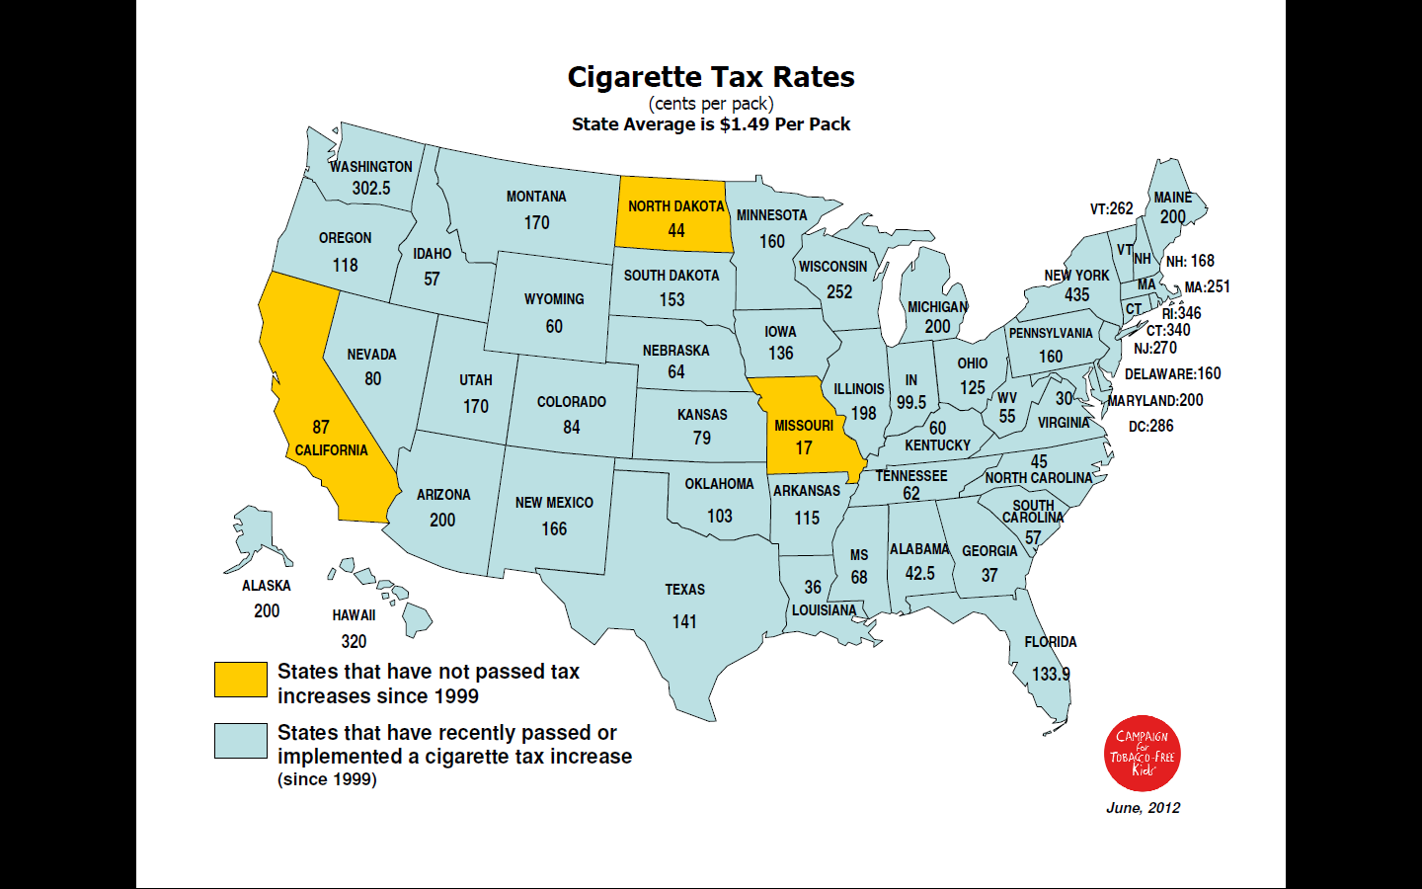

Slide 17
Federal Tobacco Tax Per Pack of Cigarettes
1951—8 cents
1982—16 cents
1991—20 cents
1993—24 cents
2001—34 cents
2002—39 cents
2009—$1.01

Slide 18
Tobacco Industry is Outspending Prevention Efforts 23:1
State Tobacco
Revenue
(taxes and settlement
funds)
$25.6 billion
Federal
Cigarette
Tax Revenues
Tobacco Industry Marketing & Promotion
Spending (2008)
$10.5 billion
$15
billion
Smokeless
Total CDC-Recommended Spending Level
Cigarettes
State Tobacco Program Budgets
$0.5 billion
$3.7 billion
Campaign for Tobacco Free Kids, Federal Trade Commission, American Heart Association American Cancer Society, American Lung Association, SmokeLess States National Tobacco Policy Initiative

Slide 19
Number of Smokers = New Smokers + Old Smokers - Quitters

Slide 20
Number of Quitters = Number of Quit Attempts X % of Quitters
Clinician advice
Price
Counseling
Counter- Marketing
Clean indoor air
Medications

Slide 21
New FDA Graphic Warnings

Slide 22
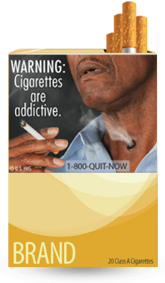
WARNING: Cigarettes are addictive.
Tobacco use can rapidly lead to the development of nicotine addiction, which in turn increases the frequency of tobacco use and prevents people from quitting. Research suggests that nicotine is as addictive as heroin, cocaine, or alcohol.

Slide 23
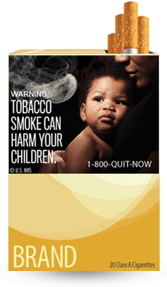
WARNING: Tobacco smoke can harm your children.
Secondhand smoke can cause serious health problems in children. Children who are exposed to secondhand smoke are inhaling many of the same cancer-causing substances and poisons as smokers.

Slide 24
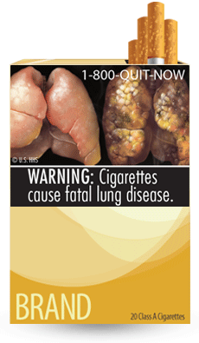
WARNING: Cigarettes cause fatal lung disease.
Smoking causes lung diseases such as emphysema, bronchitis, and chronic airway obstruction. About 90 percent of all deaths from chronic obstructive lung disease are caused by smoking.

Slide 25
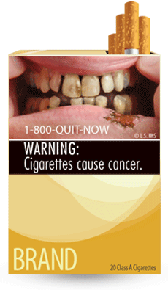
WARNING: Cigarettes cause cancer. Smoking causes approximately 90 percent of all lung cancer deaths in men and 80 percent of all lung cancer deaths in women. Smoking also causes cancers of the bladder, cervix, esophagus, kidney, larynx, lung, mouth, throat, stomach, uterus, and acute myeloid leukemia. Nearly one-third of all cancer deaths are directly linked to smoking.

Slide 26
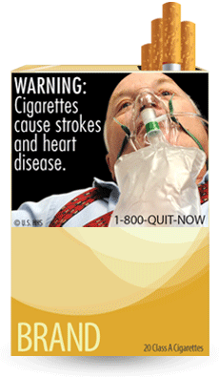
WARNING: Cigarettes cause strokes and heart disease.
More than 140,000 deaths from heart disease and stroke in the United States are caused each year by smoking and secondhand smoke exposure. Compared with nonsmokers, smoking is estimated to increase the risk of coronary heart disease and stroke by 2 to 4 times.

Slide 27
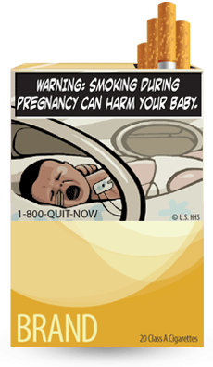
WARNING: Smoking during pregnancy can harm your baby.
Smoking during pregnancy can increase the risk of miscarriage, stillborn or premature infants, infants with low birth weight and an increased risk for sudden infant death syndrome (SIDS).

Slide 28
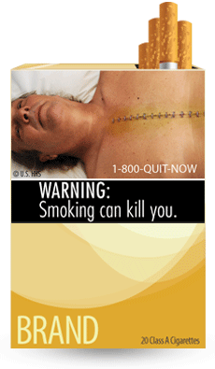
WARNING: Smoking can kill you. More than 1,200 people a day are killed by cigarettes in the United States alone, and 50 percent of all long-term smokers are killed by smoking-related diseases. Tobacco use is the cause of death for nearly one out of every five people in the United States, which adds up to about 443,000 deaths annually.

Slide 29
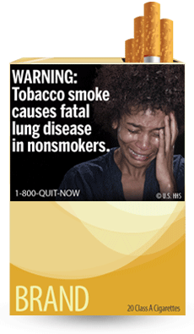
WARNING: Tobacco smoke causes fatal lung disease in nonsmokers. Nonsmokers who are exposed to secondhand smoke are inhaling many of the same cancer-causing substances and poisons as smokers. Nonsmokers who are exposed to secondhand smoke increase their risk of developing lung cancer by 20–30 percent.

Slide 30
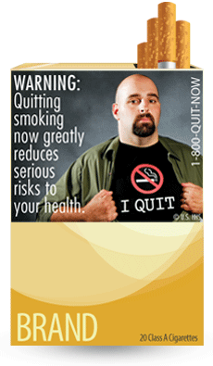
WARNING: Quitting smoking now greatly reduces serious risks to your health. Quitting at any age and at any time is beneficial. It's never too late to quit, but the sooner the better. Quitting gives your body a chance to heal the damage caused by smoking.

Slide 31
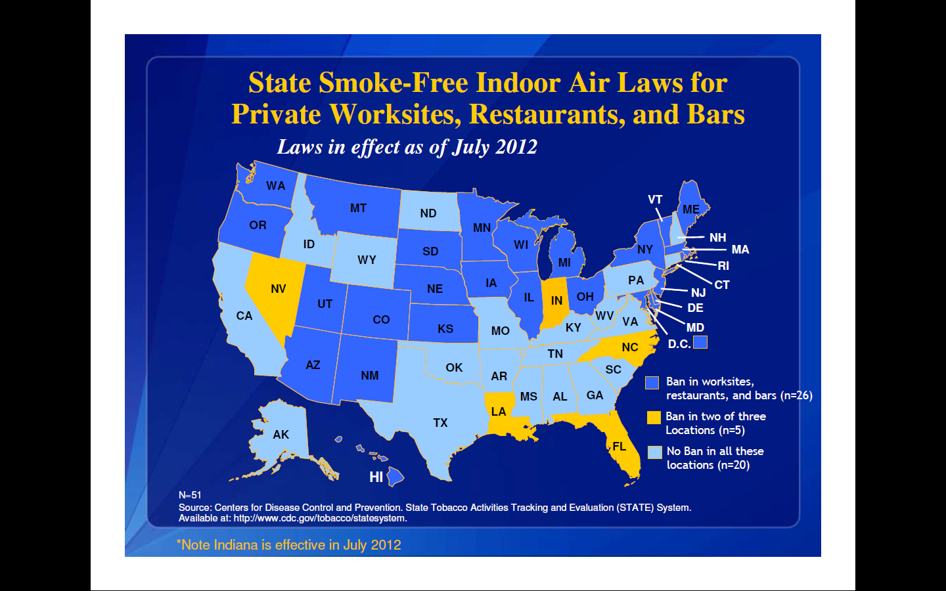

Slide 33
Clinical Issues

Slide 34
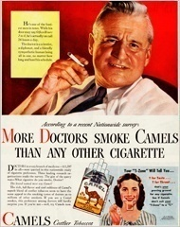
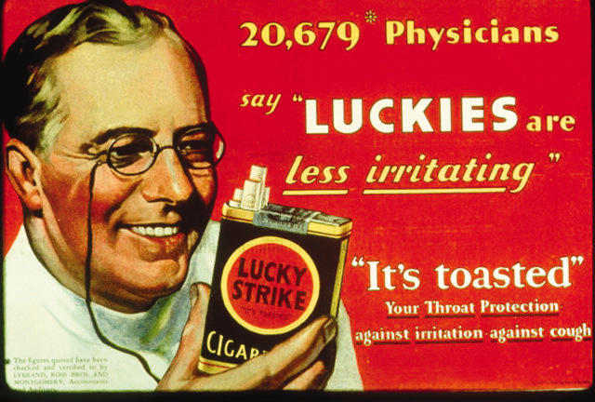
Ad campaigns from the 1950s featured physicians and assured the public that cigarettes were safe.
Notes:
34
“The Doctors’ Choice Is America’s Choice”
Gardner MN, Brandt AM. (2006). The Physician in US Cigarette Advertisements, 1930–1953. Am J Public Health 96(2):222–232.
In the 1930s and 1940s, smoking became the norm for both men and women in the United States, and a majority of physicians smoked. At the same time, there was rising public anxiety about the health risks of cigarette smoking. One strategic response of tobacco companies was to devise advertising referring directly to physicians. As ad campaigns featuring physicians developed through the early 1950s, tobacco executives used the doctor image to assure consumers that their respective brands were safe. These advertisements also suggested that the individual physicians’ clinical judgment should continue to be the arbiter of the harms of cigarette smoking even as systematic health evidence accumulated. However, by 1954, industry strategists deemed physician images in advertisements no longer credible in the face of growing public concern about the health evidence implicating cigarettes.
For a more detailed characterization of the tobacco industry’s use of physicians for marketing, see
www.pubmedcentral.nih.gov/articlerender.fcgi?artid=1470496.

Slide 35
Health Professionals’ Smoking Rates, 2004 *
Primary Care Physicians - 1.7%
Emergency Physicians - 5.7%
Psychiatrists - 3.2%
RN’s - 13.2%
Dentists - 5.8%
Dental Hygienists - 5.4%
Pharmacists – 4.5%
* E. Tong et al, Nicotine & Tobacco Research (Nicotine and Tobacco Research, May 27, 2010)

Slide 36
Reasons for Not Helping Patients Quit
1. Too busy
2. Lack of expertise
3. No financial incentive
4. Lack of available treatments and/or coverage
5. Most smokers can’t/won’t quit
6. Stigmatizing smokers
7. Respect for privacy
8. Negative message might scare away patients
9. I smoke myself

Slide 37
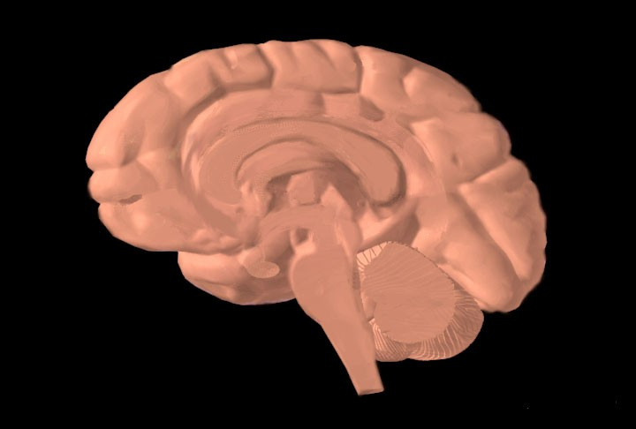
Dopamine Reward Pathway
Prefrontal cortex
Dopamine release
Stimulation of nicotine receptors
Nucleus accumbens
Ventral tegmental area
Nicotine enters brain
Notes:
Drugs such as cocaine, heroin, amphetamine, and nicotine exert profound effects on the brain. These agents have in common the ability to stimulate the release of the neurotransmitter dopamine in the midbrain. Dopamine induces feelings of euphoria and pleasure and is responsible for activating the dopamine reward pathway (Leshner, 1997).
The dopamine reward pathway, as depicted in this simplified diagram, is a network of nervous tissue in the middle of the brain that elicits feelings of pleasure in response to certain stimuli. The important interconnected structures of the reward pathway include the ventral tegmental area (VTA), the nucleus accumbens, and the prefrontal cortex (area of the brain responsible for thinking and judgment). The neurons of the VTA contain the neurotransmitter dopamine, which is released in the nucleus accumbens and in the prefrontal cortex.
Behaviors that naturally stimulate the reward pathway include eating to relieve hunger, drinking to alleviate thirst, or engaging in sexual activity. On a primitive, neurochemical level, stimulation of the reward pathway reinforces the behavior so that it will be repeated. Obviously these behaviors are necessary for continued survival of the organism. The reward pathway can also be stimulated by drugs of abuse such as cocaine, opiates, amphetamine, and nicotine. When these unnatural stimuli trigger the reward pathway the same pleasurable feelings are elicited. Researchers believe that, with chronic drug use, the brain becomes chemically altered—transforming a drug user into a drug addict (Leshner, 1997).
Consider cigarette smoking as an example. Immediately following inhalation, a bolus of nicotine enters the brain, stimulating the release of dopamine, which induces nearly immediate feelings of pleasure and relief of symptoms of nicotine withdrawal. This rapid dose-response reinforces and perpetuates the smoking behavior.
This slide is made available to the public through the National Institute on Drug Abuse Web page, at www.nida.nih.gov/Teaching/largegifs/slide-9.gif. Adapted with permission by Dr. Rochelle D. Schwartz-Bloom, Duke University.
Leshner Al. (1997, April). Drug abuse and addiction are biomedical problems. Hosp Pract (special report):2–4.
Slide is used with permission, Rx for Change: Clinician-Assisted Tobacco Cessation. Copyright © 1999-2009 The Regents of the University of California. All rights reserved.

Slide 38
Chronic Administration of Nicotine: Effects on the Brain
Human smokers have increased nicotine receptors in the prefrontal cortex.
High
Low
Nonsmoker
Smoker
Image courtesy of George Washington University / Dr. David C. Perry
Perry et al. (1999). J Pharmacol Exp Ther 289:1545–1552.
Notes:
Chronic administration of nicotine results in an increased number of CNS nicotine receptors in smokers compared to non-smokers (Breese et al., 1997; Perry et al., 1999). This upregulation of nicotine receptors leads to the development of tolerance, by which repeated doses of a drug produce less of an effect than did the initial exposure. Post-mortem data suggest these smoking-induced changes are reversible following smoking cessation (Breese et al., 1997).
Breese CR, Marks MJ, Logel J, et al. (1997). Effect of smoking history on [3H]nicotine binding in human postmortem brain. J Pharmacol Exp Ther 282:7–13.
Perry DC, Davila-Garcia MI, Stockmeier CA, Kellar KJ. (1999). Increased nicotinic receptors in brains from smokers: Membrane binding and autoradiography studies. J Pharmacol Exp Ther 289:1545–1552.
Slide is used with permission, Rx for Change: Clinician-Assisted Tobacco Cessation. Copyright © 1999-2009 The Regents of the University of California. All rights reserved.

Slide 39
Nicotine Pharmacodynamics: Withdrawal Effects
Irritability/frustration/anger
Anxiety
Difficulty concentrating
Restlessness/impatience
Depressed mood/depression
Insomnia
Impaired performance
Increased appetite/weight gain
Cravings
Most symptoms manifest within the first 1–2 days, peak within the first week, and subside within 2–4 weeks.
Hughes. (2007). Nicotine Tob Res 9:315–327.
Notes:
♪ Note to instructor(s): Refer students to the Withdrawal Symptoms Information Sheet handout. This handout describes several symptoms, when they occur postcessation, and how to cope with withdrawal. In addition to being an educational aid for students, it can be copied and distributed to patients who are quitting.
When nicotine is discontinued abruptly, the following withdrawal symptoms develop (Hughes, 2007):
Irritability/frustration/anger
Anxiety
Difficulty concentrating
Restlessness/impatience
Depressed mood/depression
Insomnia
Impaired performance
Increased appetite/weight gain
Cravings
♪ Note to instructor(s): Other symptoms of quitting have been described in the literature. Please refer to Hughes, 2007 for further details.
Tobacco users usually experience a strong desire or craving for tobacco. In general, withdrawal symptoms manifest within the first 1–2 days, peak within the first week, and gradually dissipate over the next 2–4 weeks (Hughes, 2007). Strong cravings for tobacco may persist for months to years after cessation (Benowitz, 1992).
Benowitz NL. (1992). Cigarette smoking and nicotine addiction. Med Clin N Am 76:415–437.
Hughes JR. (2007). Effects of abstinence from tobacco: valid symptoms and time course. Nicotine Tob Res 9:315–27.
Hughes JR, Hatsukami D. (1998). Errors in using tobacco withdrawal scale (letter to the editor). Tob Control 7:92–93.
Slide is used with permission, Rx for Change: Clinician-Assisted Tobacco Cessation. Copyright © 1999-2009 The Regents of the University of California. All rights reserved.

Slide 40
LONG-TERM (≥6 month) QUIT RATES for AVAILABLE CESSATION MEDICATIONS
23.9
20.2
18.0
19.0
15.8
16.1
17.1
Percent quit
11.3
11.8
11.2
10.3
9.9
8.1
9.1
Data adapted from Cahill et al. (2008). Cochrane Database Syst Rev; Stead et al. (2008).
Cochrane Database Syst Rev; Hughes et al. (2007). Cochrane Database Syst Rev
Notes:
40
This bar chart summarizes the long-term (≥6-month) quit rates observed with the different NRT products, bupropion SR and varenicline (Cahill et al., 2008; Stead et al., 2008; Hughes et al., 2007). These data derive from 145 different randomized-controlled trials; therefore, it is inappropriate to compare the active medications with respect to clinical efficacy. What this chart does illustrate, however, is that the quit rates from each of the methods is approximately twice that of its corresponding placebo control treatment arm.
Each of the pharmacotherapy options depicted in the chart is considered effective. When patients ask for assistance with their quit attempt, any product can be recommended, if not contraindicated. However, when assisting patients in choosing a product, clinicians should consider additional factors. The number of cigarettes smoked per day (or time to first cigarette, for the nicotine lozenge), level of dependence, advantages and disadvantages of each product, methods used for prior quit attempts and reasons for relapse, and the patient’s own product preference need to be considered. Behavioral counseling should be used in conjunction with all pharmacologic therapies.
Cahill K, Stead LF, Lancaster T. Nicotine receptor partial agonists for smoking cessation. (2008). Cochrane Database Syst Rev 3:CD006103.
Hughes JR, Stead LF, Lancaster. (2007). Antidepressants for smoking cessation. Cochrane Database Syst Rev 4:CD000031.
Stead LF, Perera R, Bullen C, Mant D, Lancaster T. (2008). Nicotine replacement therapy for smoking cessation. Cochrane Database Syst Rev 1:CD000146.
Slide is used with permission, Rx for Change: Clinician-Assisted Tobacco Cessation. Copyright © 1999-2009 The Regents of the University of California. All rights reserved.

Slide 41
Quitlines

Slide 42
What Are “Tobacco Quitlines”?
Tobacco cessation counseling, provided at no cost via telephone to all Americans
Staffed by trained specialists
Up to 4–6 personalized sessions (varies by state)
Some state quitlines offer nicotine replacement therapy at no cost (or reduced cost)
Up to 30% success rate for patients who complete sessions
Most health-care providers, and most patients,
are not familiar with tobacco quitlines.
Notes:
What is a tobacco quitline? Tobacco quitlines are telephone services that provide tobacco cessation counseling at no cost to the caller. Quitlines have proliferated over the past decade, providing comprehensive interventions that can reach patients who might otherwise have limited access to medical treatment because of geographic location or lack of insurance or financial resources. In clinical trials, telephone counseling services for which at least some of the contacts are initiated by the quitline counselor have been shown to be effective in promoting abstinence (Fiore et al., 2008), and these positive results have been shown to translate into real-world effectiveness (Zhu et al., 2000). The addition of medication to quitline counseling significantly improves abstinence rates compared to medication alone (Fiore et al., 2008). In addition, preliminary evidence suggests that that quitlines also are effective for smokeless tobacco cessation (Severson et al., 2000). The telephone number for the toll-free tobacco quitline is 1-800-QUIT NOW. In some states, clinicians can submit a fax-referral form, on behalf of a patient, to the quitline. This form initiates a process whereby a quitline counselor then contacts the patient directly. Up to 30% success rates have been shown for patients who complete all follow-up sessions. However, most physicians, and most smokers, know almost nothing about them, so they are not being utilized by most smokers who want to quit. Even the busiest of clinicians can serve an important role by simply identifying tobacco users and referring them to a quitline for more comprehensive counseling.
Fiore MC, Jaén CR, Baker TB, et al. (2008). Treating Tobacco Use and Dependence: 2008 Update. Clinical Practice Guideline. Rockville, MD: U.S. Department of Health and Human Services. Public Health Service.
Severson HH,et al. (2000). A self-help cessation program for smokeless tobacco users: Comparison of two interventions. Nicotine Tob Res 2:363–370.
Zhu SH, et al. (2002). Evidence of real-world effectiveness of a telephone quitline for smokers. N Engl J Med 347:1087–1093.

Slide 43
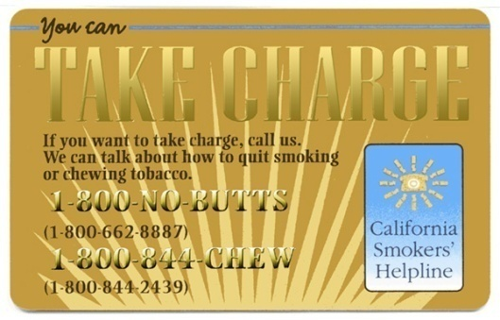
California’s 1-800-NO BUTTS
—
43
Notes:
43
43

Slide 44
Quitline Calls Are Increasing
# callers to all national quitlines was 222,000 in 2005, 516,000 in 2009
In a period when smoking prevalence was declining and states were cutting back on marketing budgets
63% North Carolina callers reported history of mental illness
New studies showing that web-based cessation protocols yield better results when linked to quitlines

Slide 45
Conclusions

Slide 46
The Electronic Cigarette *
Aerosolizes nicotine in propylene glycol soluent
Cartridges contain about 20 mg nicotine
Safety unproven, but >cigarette smoke
Bridge use or starter product?
Probably deliver < nicotine than promised
Not approved by FDA
My advice: avoid unless patient insists
* Cobb & Abrams. NEJM July 21, 2011

Slide 47
Tobacco Tipping Point?
California 11.9% adult smoking prevalence in 2010
National prevalence in 2007 at modern low—(19.8%), 20.6% in 2008 and 2009; 19.3% in 2010!!
Smokers smoke fewer cigarettes
Northern California Kaiser Permanente at 9%
Physician smoking prevalence at 1%
New FDA warning photos on cigarette packs--2012

Slide 48
Tobacco Tipping Point (2)
Proliferation of smoke-free areas
Higher insurance premiums for smokers
April 2009 62 cent/pack federal tax increase
Lung cancer deaths in women start to fall
Increasing stigmatization of smoking
National mass media campaigns—FDA and CDC—in 2012

