Slide 1
What Physicians Should Know about Smoking:2012
Steven A. Schroeder, MD
Medical Grand Rounds, Oct 4, 2012
The Smoking Cessation Leadership Center
and Rx for Change

Slide 3
How Did I Get into this Field?
Career goals of influencing policy, plus merging clinical medicine and public health
Personal influences
--Parents who smoked, but no illnesses
--Never much liked it myself
--Became a “no/no” for college dating

Slide 4
Formative Experiences (2)
Saw the clinical ravages of tobacco use
Encouraged research in this arena among our faculty in DGIM
When arrived at RWJF, was surprised that no foundations were supporting tobacco control work, despite its importance
Difficult sell at RWJF
But ultimately spent about $500 million

Slide 5
Experiences (3)
RWJF work on tobacco listed by Joel Fleishman in his 2007 book, The Foundation: How Private Wealth is Changing the World, as one of 12 “high impact initiatives in the past 100 years”, along with the Flexner Report, the Green Revolution, and Public Broadcasting

Slide 6
Updates
Facts about smoking and health
Tobacco use epidemiology
Tobacco control policies
Clinical issues
Lessons learned at the Smoking Cessation Leadership Center @ UCSF
Conclusion and next steps

Slide 7
Facts About Smoking and Health

Slide 8
Tobacco’s Deadly Toll
443,000 deaths in the U.S. each year
4.8 million deaths world wide each year
10 million deaths estimated by year 2030
50,000 deaths in the U.S. due to second-hand smoke exposure
8.6 million disabled from tobacco in the U.S. alone
45.3 million smokers in U.S. (78% daily smokers, averaging 13 cigarettes/day, 2010)

Slide 9
Health Consequences of Smoking
Cancers
Acute myeloid leukemia
Bladder and kidney
Cervical
Esophageal
Gastric
Laryngeal
Lung
Oral cavity and pharyngeal
Pancreatic
Prostate (↑incidence and ↓survival)
Pulmonary diseases
Acute (e.g., pneumonia)
Chronic (e.g., COPD)
Cardiovascular diseases
Abdominal aortic aneurysm
Coronary heart disease
Cerebro-vascular disease
Peripheral arterial disease
Type 2 diabetes mellitus
Reproductive effects
Reduced fertility in women
Poor pregnancy outcomes (e.g., low birth weight, preterm delivery)
Infant mortality; childhood obesity
Other effects: cataract, osteoporosis, periodontitis, poor surgical outcomes, Alzheimers; rheumatoid arthritis;less sleep
U.S. Department of Health and Human Services.
The Health Consequences of Smoking: A Report of the Surgeon General, 2010.
Notes:
The 2004 Surgeon General’s Report on the health consequences of smoking describes a long list of diseases with sufficient evidence to infer a causal relationship with smoking.
♪ Note to instructor(s): For more detailed information and literature citations regarding risks for these tobacco-related illnesses, refer to the Pathophysiology of Tobacco-Related Disease module or the Surgeon General’s Report at http://www.surgeongeneral.gov/library/smokingconsequences.
U.S. Department of Health and Human Services. The Health Consequences of Smoking: A Report of the Surgeon General. U.S. Department of Health and Human Services, Centers for Disease Control and Prevention, National Center for Chronic Disease Prevention and Health Promotion, Office on Smoking and Health, 2004. Available at http://www.surgeongeneral.gov/library/smokingconsequences. Accessed May 29, 2004.
Slide is used with permission, Rx for Change: Clinician-Assisted Tobacco Cessation. Copyright © 1999-2009 The Regents of the University of California. All rights reserved.

Slide 10
Annual U.S. Deaths Attributable to Smoking, 2000–2004
Percent of all smoking-attributable deaths
Cardiovascular diseases | 128,497
Lung cancer | 125,522
Respiratory diseases | 103,338
Second-hand smoke | 49,400
Cancers other than lung | 35,326
Other | 1,512
29%
28%
23%
11%
8%
<1%
TOTAL: 443,595 deaths annually
Centers for Disease Control and Prevention. MMWR 2008;571226–1228.
Notes:
Cigarette smoking is the primary known preventable cause of premature death in the U.S. Each year, nearly half a million Americans die from cigarette smoking; one of every five deaths in the U.S. is smoking related (CDC, 2008). This number surpasses the combined death toll due to alcohol, car accidents, suicides, homicides, HIV disease, and illicit drug use.
Average number of years of life lost because of smoking, for male and female smokers (CDC, 2002):
Males 13.2 years
Females 14.5 years
A total of 443,595 annual deaths due to cigarette smoking are reported by the CDC (2008) as follows:
Cardiovascular disease………… 128,497
Ischemic heart disease, other heart diseases, cerebrovascular diseases, atherosclerosis, aortic aneurysm, other circulatory diseases
Lung cancer………………………125,522
Trachea, lung, bronchus (not including lung cancer due to second-hand smoke exposure)
Respiratory diseases…………….103,338
Pneumonia, influenza, bronchitis, emphysema, chronic airway obstruction
Second-hand smoke……………....49,400
Cancers other than lung…………..35,326
Lip, oral cavity, pharynx, esophagus, pancreas, larynx, cervix, uterus, urinary bladder, kidney, other urinary
Other………………………………….1,512
Centers for Disease Control and Prevention. Annual smoking-attributable mortality, years of potential life lost, and productivity losses—United States, 2000–2004. MMWR 2008;57:1126–1128.
Slide is used with permission, Rx for Change: Clinician-Assisted Tobacco Cessation. Copyright © 1999-2009 The Regents of the University of California. All rights reserved.

Slide 12
Cumulative risk (%)
Reduction in cumulative risk of death from lung cancer in men
Age in years
Reprinted with permission. Peto et al. (2000). BMJ 321(7257):323–329.
Notes:
Despite the detrimental effects of tobacco on pulmonary health, smoking cessation can lead to a significant reduction in the cumulative risk of death from lung cancer. This graph demonstrates the risk of lung cancer mortality incurred by men at age 75; the risk estimates are 15.9% for those who do not quit smoking cigarettes and 9.9%, 6.0%, 3.0%, and 1.7% for men who stopped at ages 60, 50, 40, and 30, respectively (Peto et al., 2000). Similar trends are seen for women. These aggregate data suggest that quitting, at any age, reduces the risk of death from lung cancer.
Peto R, Darby S, Deo H, Silcocks P, Whitley E, Doll R. (2000). Smoking, smoking cessation, and lung cancer in the UK since 1950: Combination of national statistics with two case-control studies. BMJ 321(7257):323–329.
Slide is used with permission, Rx for Change: Clinician-Assisted Tobacco Cessation. Copyright © 1999-2009 The Regents of the University of California. All rights reserved.

Slide 13
Smoking and Mental Illness: The Heavy Burden
200,000 annual deaths from smoking occur among patients with CMI and/or substance abuse
This population consumes 44% of all cigarettes sold in the United States
-- higher prevalence
-- smoke more
-- more likely to smoke down to the butt
People with CMI die on average 25 years earlier than others, and smoking is a large contributor to that early mortality
Social isolation from smoking compounds the social stigma

Slide 14
Causal Associations with Second-hand Smoke
There is no safe level of second-hand smoke.
Developmental
Low birth-weight
Sudden infant death syndrome (SIDS)
Pre-term delivery
-- Childhood depression
Respiratory
Asthma induction and exacerbation
Eye and nasal irritation
Bronchitis, pneumonia, otitis media, bruxism in children
Decreased hearing in teens
Carcinogenic
Lung cancer
Nasal sinus cancer
Breast cancer (younger, premenarche women)
Cardiovascular
Heart disease mortality
Acute and chronic coronary heart disease morbidity
Altered vascular properties
USDHHS. (2006). The Health Consequences of Involuntary Exposure to Tobacco Smoke: Report of the Surgeon General.

Slide 15
Epidemiology of Tobacco Use

Slide 16
Adult Smoking Prevalence U.S.A. 1955-2009
Source: Centers for Disease Control and Prevention (Schroeder and Warner, NEJM, July 2010)

Slide 17
Smoking Prevalence and Average Number of Cigarettes Smoked per Day per Current Smoker 1965-2010
Percent/Number of Cigarettes Smoked Daily
Source: Centers for Disease Control and Prevention (1965-2010). NHIS

Slide 18
Declines in Heavy (≥ 20cpd) Smoking, California and Rest of U. S.*
Year | California (%) | Rest of U.S. (%)
1965 | 23.2 | 22.9
1979 | 17.9 | 20.5
1989 | 10.6 | 14.8
1999 | 4.8 | 10.7
2007 | 2.6 (overall prevalence 11.3) | 7.2 (overall 17.9)
* Pierce et al. JAMA 2011;305:1106-1112

Slide 19
PREVALENCE of ADULT SMOKING, by EDUCATION—U.S., 2009
26.4% No high school diploma
49.1% GED diploma
25.1% High school graduate
23.3% Some college
11.1% Undergraduate degree
5.6% Graduate degree
Centers for Disease Control and Prevention. (2010). MMWR 59:1135–1140.
Notes:
In 2005, the prevalence of current smoking¹ in the U.S. was highest among adults (aged 25 years or older) who had received a General Educational Development (GED) diploma (43.2%). Persons with a graduate degree (masters, professional, or doctorate) had the lowest prevalence (7.1%) (CDC, 2006).
Also notable is the fact that the prevalence of adult smoking is associated with poverty level. The prevalence is 20.6% for persons who are at or above the poverty level and 29.9% for persons who are below the poverty level (CDC, 2006).
The smoking prevalence is 24.4% for persons aged 18–24; 24.1% for persons aged 25–44; 21.9% for persons aged 45–64; and 8.6% for persons at least 65 years of age (CDC, 2006).
¹Current smokers: persons who reported having smoked 100 or more cigarettes during their lifetime and who smoked every day or some days at the time of the interview.
Centers for Disease Control and Prevention. (2006). Tobacco use among adults—United States, 2005. MMWR 55:1145–1148.
Slide is used with permission, Rx for Change: Clinician-Assisted Tobacco Cessation. Copyright © 1999-2009 The Regents of the University of California. All rights reserved.

Slide 20
PREVALENCE of ADULT SMOKING, by RACE/ETHNICITY—U.S., 2010
31.4% American Indian/Alaska Native*
21.0% White*
20.6% Black*
14.5% Hispanic
12% Asian*
* non-Hispanic.
Centers for Disease Control and Prevention. (2010). MMWR.
Notes:
In 2005, the prevalence of smoking in the U.S. was highest among American Indian/Alaska Natives (32.0%) and next highest among non-Hispanic Whites (21.9%), followed by non-Hispanic Blacks (21.5%), Hispanics (16.2%), and Asians (13.3%) (CDC, 2006).
Centers for Disease Control and Prevention. (2006). Tobacco use among adults—United States, 2005. MMWR 55:1145–1148.
Slide is used with permission, Rx for Change: Clinician-Assisted Tobacco Cessation. Copyright © 1999-2009 The Regents of the University of California. All rights reserved.

Slide 21
Tobacco Control Policies

Slide 22
Number of Smokers = New Smokers + Old Smokers - Quitters

Slide 23
Number of Quitters = Number of Quit Attempts X % of Quitters
Clinician advice
Price
Counseling
Counter- Marketing
Clean indoor air
Medications

Slide 24
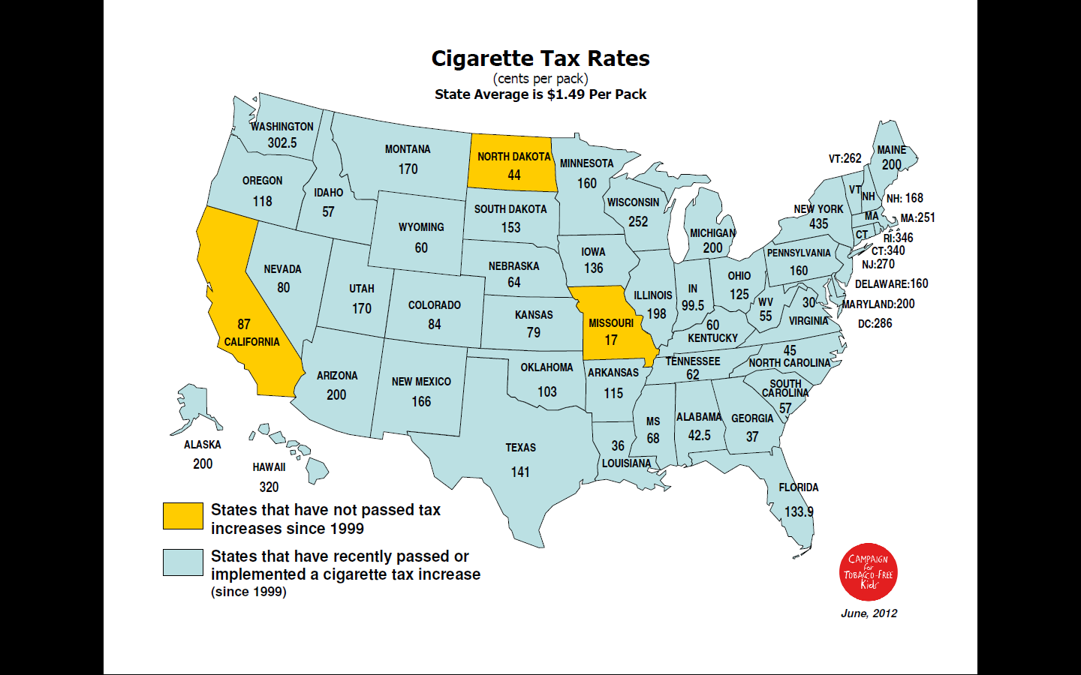

Slide 25
Federal Tobacco Tax Per Pack of Cigarettes
1951—8 cents
1982—16 cents
1991—20 cents
1993—24 cents
2001—34 cents
2002—39 cents
2009—$1.01

Slide 26
Tobacco Industry is Outspending Prevention Efforts 23:1
State Tobacco
Revenue
(taxes and settlement
funds)
$25.6 billion
Federal
Cigarette
Tax Revenues
Tobacco Industry Marketing & Promotion
Spending (2008)
$10.5 billion
$15
billion
Smokeless
Total CDC-Recommended Spending Level
Cigarettes
State Tobacco Program Budgets
$0.5 billion
$3.7 billion
Campaign for Tobacco Free Kids, Federal Trade Commission, American Heart Association American Cancer Society, American Lung Association, SmokeLess States National Tobacco Policy Initiative

Slide 27
New FDA Graphic Warnings

Slide 28
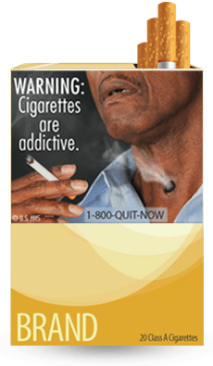
WARNING: Cigarettes are addictive.
Tobacco use can rapidly lead to the development of nicotine addiction, which in turn increases the frequency of tobacco use and prevents people from quitting. Research suggests that nicotine is as addictive as heroin, cocaine, or alcohol.

Slide 29
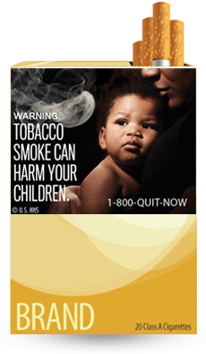
WARNING: Tobacco smoke can harm your children.
Secondhand smoke can cause serious health problems in children. Children who are exposed to secondhand smoke are inhaling many of the same cancer-causing substances and poisons as smokers.

Slide 30
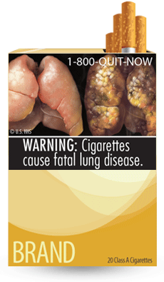
WARNING: Cigarettes cause fatal lung disease.
Smoking causes lung diseases such as emphysema, bronchitis, and chronic airway obstruction. About 90 percent of all deaths from chronic obstructive lung disease are caused by smoking.

Slide 31
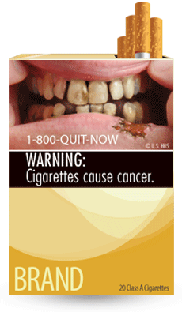
WARNING: Cigarettes cause cancer. Smoking causes approximately 90 percent of all lung cancer deaths in men and 80 percent of all lung cancer deaths in women. Smoking also causes cancers of the bladder, cervix, esophagus, kidney, larynx, lung, mouth, throat, stomach, uterus, and acute myeloid leukemia. Nearly one-third of all cancer deaths are directly linked to smoking.

Slide 32
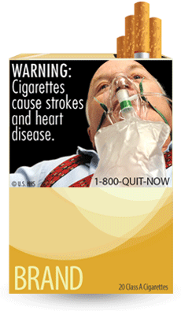
WARNING: Cigarettes cause strokes and heart disease.
More than 140,000 deaths from heart disease and stroke in the United States are caused each year by smoking and secondhand smoke exposure. Compared with nonsmokers, smoking is estimated to increase the risk of coronary heart disease and stroke by 2 to 4 times.

Slide 33
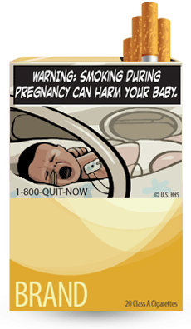
WARNING: Smoking during pregnancy can harm your baby.
Smoking during pregnancy can increase the risk of miscarriage, stillborn or premature infants, infants with low birth weight and an increased risk for sudden infant death syndrome (SIDS).

Slide 34
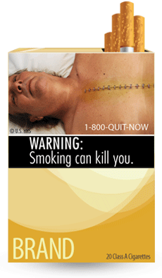
WARNING: Smoking can kill you. More than 1,200 people a day are killed by cigarettes in the United States alone, and 50 percent of all long-term smokers are killed by smoking-related diseases. Tobacco use is the cause of death for nearly one out of every five people in the United States, which adds up to about 443,000 deaths annually.

Slide 35
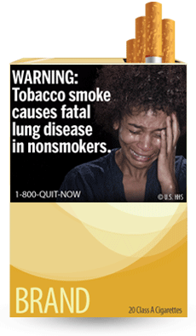
WARNING: Tobacco smoke causes fatal lung disease in nonsmokers. Nonsmokers who are exposed to secondhand smoke are inhaling many of the same cancer-causing substances and poisons as smokers. Nonsmokers who are exposed to secondhand smoke increase their risk of developing lung cancer by 20–30 percent.

Slide 36
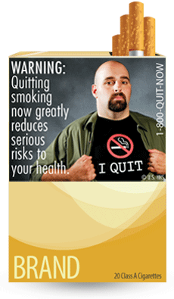
WARNING: Quitting smoking now greatly reduces serious risks to your health. Quitting at any age and at any time is beneficial. It's never too late to quit, but the sooner the better. Quitting gives your body a chance to heal the damage caused by smoking.

Slide 37
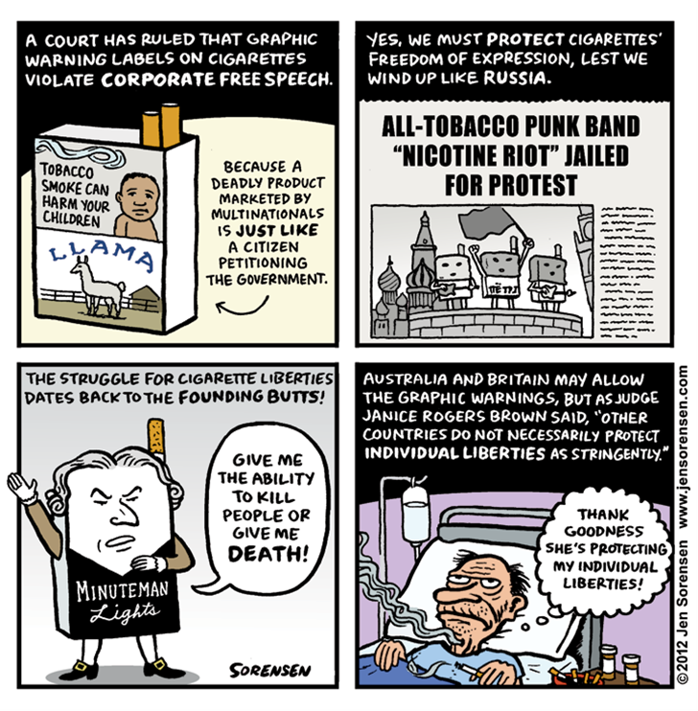
Judicial Restraint?

Slide 38
Clinical Issues

Slide 39
Physicians Under-treat Smokers*
AAMC 2007 survey of 3012 physicians representing FM, GIM, Ob-Gyn, Psych
Only 1% were current smokers
84% asked about smoking
86% advised to quit
31% recommended NRT
17% arranged follow-up
7% referred to quitlines
*AAMC-Legacy survey: Physician behavior and practice patterns related to smoking cessation, 2007.

Slide 40
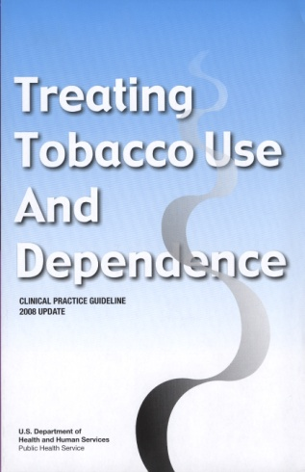
The 5 A’s: Review
ASK
about tobacco USE
ADVISE
tobacco users to QUIT
ASSESS
readiness to make a QUIT attempt
ASSIST
with the QUIT ATTEMPT
ARRANGE
FOLLOW-UP care
Fiore et al. (2008). Treating Tobacco Use and Dependence: 2008 Update.
Clinical Practice Guideline. Rockville, MD: USDHHS, PHS, May 2008.
Notes:
As a final review, the 5 A’s are
Ask about tobacco use.
Advise tobacco users to quit.
Assess readiness make a quit attempt.
Assist with the quit attempt.
Arrange follow-up care.
Each of these is a key component of comprehensive tobacco cessation counseling interventions.
Slide is used with permission, Rx for Change: Clinician-Assisted Tobacco Cessation. Copyright © 1999-2009 The Regents of the University of California. All rights reserved.
Slide is used with permission, Rx for Change: Clinician-Assisted Tobacco Cessation. Copyright © 1999-2007 The Regents of the University of California, University of Southern California, and Western University of Health Sciences. All rights reserved.

Slide 41
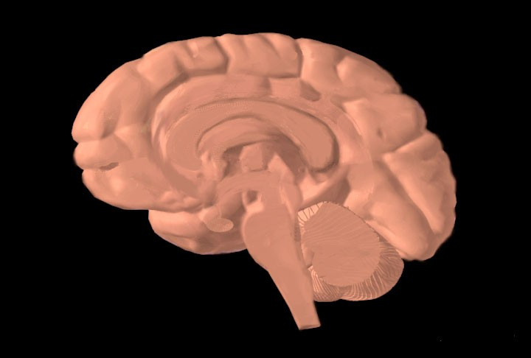
Dopamine Reward Pathway
Prefrontal cortex
Dopamine release
Stimulation of nicotine receptors
Nucleus accumbens
Ventral tegmental area
Nicotine enters brain
Notes:
Drugs such as cocaine, heroin, amphetamine, and nicotine exert profound effects on the brain. These agents have in common the ability to stimulate the release of the neurotransmitter dopamine in the midbrain. Dopamine induces feelings of euphoria and pleasure and is responsible for activating the dopamine reward pathway (Leshner, 1997).
The dopamine reward pathway, as depicted in this simplified diagram, is a network of nervous tissue in the middle of the brain that elicits feelings of pleasure in response to certain stimuli. The important interconnected structures of the reward pathway include the ventral tegmental area (VTA), the nucleus accumbens, and the prefrontal cortex (area of the brain responsible for thinking and judgment). The neurons of the VTA contain the neurotransmitter dopamine, which is released in the nucleus accumbens and in the prefrontal cortex.
Behaviors that naturally stimulate the reward pathway include eating to relieve hunger, drinking to alleviate thirst, or engaging in sexual activity. On a primitive, neurochemical level, stimulation of the reward pathway reinforces the behavior so that it will be repeated. Obviously these behaviors are necessary for continued survival of the organism. The reward pathway can also be stimulated by drugs of abuse such as cocaine, opiates, amphetamine, and nicotine. When these unnatural stimuli trigger the reward pathway the same pleasurable feelings are elicited. Researchers believe that, with chronic drug use, the brain becomes chemically altered—transforming a drug user into a drug addict (Leshner, 1997).
Consider cigarette smoking as an example. Immediately following inhalation, a bolus of nicotine enters the brain, stimulating the release of dopamine, which induces nearly immediate feelings of pleasure and relief of symptoms of nicotine withdrawal. This rapid dose-response reinforces and perpetuates the smoking behavior.
This slide is made available to the public through the National Institute on Drug Abuse Web page, at www.nida.nih.gov/Teaching/largegifs/slide-9.gif. Adapted with permission by Dr. Rochelle D. Schwartz-Bloom, Duke University.
Leshner Al. (1997, April). Drug abuse and addiction are biomedical problems. Hosp Pract (special report):2–4.
Slide is used with permission, Rx for Change: Clinician-Assisted Tobacco Cessation. Copyright © 1999-2009 The Regents of the University of California. All rights reserved.

Slide 42
Caveats About Cessation Literature
Smoking is a chronic condition, yet drug treatment often short (12 weeks) in contrast to methadone maintenance
Subjects smoke at least 10-15 cigs/day, often more
Volunteers for studies likely to be more motivated to quit
Placebo and drug groups tend to have more intensive counseling than found in real practice world; counseling is not a monolithic black box
Most drug trials exclude patients with mental illness

Slide 43
LONG-TERM (≥6 month) QUIT RATES for AVAILABLE CESSATION MEDICATIONS
23.9
20.2
18.0
19.0
15.8
16.1
17.1
Percent quit
11.3
11.8
11.2
10.3
9.9
8.1
9.1
Data adapted from Cahill et al. (2008). Cochrane Database Syst Rev; Stead et al. (2008).
Cochrane Database Syst Rev; Hughes et al. (2007). Cochrane Database Syst Rev
Notes:
43
This bar chart summarizes the long-term (≥6-month) quit rates observed with the different NRT products, bupropion SR and varenicline (Cahill et al., 2008; Stead et al., 2008; Hughes et al., 2007). These data derive from 145 different randomized-controlled trials; therefore, it is inappropriate to compare the active medications with respect to clinical efficacy. What this chart does illustrate, however, is that the quit rates from each of the methods is approximately twice that of its corresponding placebo control treatment arm.
Each of the pharmacotherapy options depicted in the chart is considered effective. When patients ask for assistance with their quit attempt, any product can be recommended, if not contraindicated. However, when assisting patients in choosing a product, clinicians should consider additional factors. The number of cigarettes smoked per day (or time to first cigarette, for the nicotine lozenge), level of dependence, advantages and disadvantages of each product, methods used for prior quit attempts and reasons for relapse, and the patient’s own product preference need to be considered. Behavioral counseling should be used in conjunction with all pharmacologic therapies.
Cahill K, Stead LF, Lancaster T. Nicotine receptor partial agonists for smoking cessation. (2008). Cochrane Database Syst Rev 3:CD006103.
Hughes JR, Stead LF, Lancaster. (2007). Antidepressants for smoking cessation. Cochrane Database Syst Rev 4:CD000031.
Stead LF, Perera R, Bullen C, Mant D, Lancaster T. (2008). Nicotine replacement therapy for smoking cessation. Cochrane Database Syst Rev 1:CD000146.
Slide is used with permission, Rx for Change: Clinician-Assisted Tobacco Cessation. Copyright © 1999-2009 The Regents of the University of California. All rights reserved.

Slide 44
Questions About Light Smokers
Do smoking cessation medications work? Mayo Clinic treats light smokers with NRT.
Nicotine addiction not as important. So why can’t they quit, what are the reinforcers?
Why are they concentrated among young adults?
Does over the counter access to nicotine replacement therapies reduce chances of successful quits?
*

Slide 45
Myths About Smoking and Mental Illness*
Tobacco is necessary self-medication (industry has supported this myth)
They are not interested in quitting (same % wish to quit as general population)
They can’t quit (quit rates same or slightly lower than general population)
Quitting worsens recovery from the mental illness (not so; and quitting increases sobriety for alcoholics)
It is a low priority problem (smoking is the biggest killer for those with mental illness or substance abuse issues)
* Prochaska, NEJM, July 21, 2011

Slide 46
Efficacy and Average Sample Size of Tobacco Cessation Studies Reviewed by the Cochrane Library†
Type of Intervention | Odds Ratio (95% CI*) | Average Sample Size, per trial
Nicotine Replacement Therapy (NRT, n=98*) | 1.74 (1.64, 1.86) | 385
Telephone Counseling (TC, n=13*) | 1.56 (1.38, 1.77) | 1,100
*n indicates number of studies; CI. Confidence interval.
†Based on Silagy et al. (2004) and Stead et al. (2004). The Cochrane Library.

Slide 47
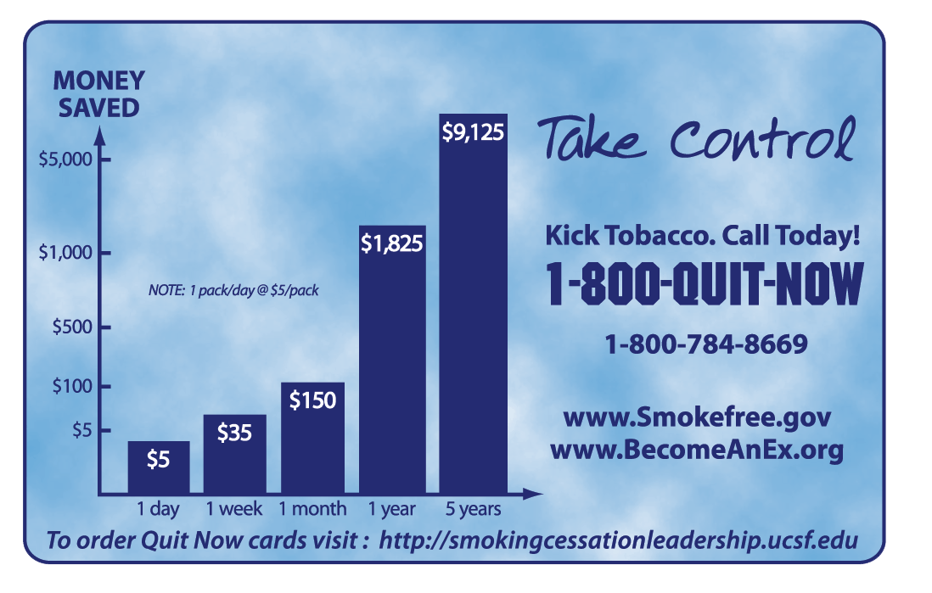
The National Quitline Card (5 million in circulation)
—

Slide 48
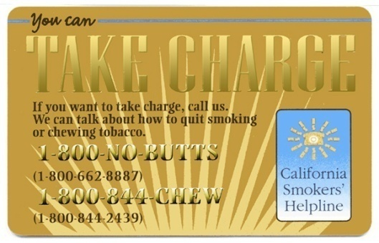
California’s 1-800-NO BUTTS
—
48
Notes:
48
48

Slide 49
Smoking Cessation Leadership Center (SCLC) at UCSF
Established in 2003 with grants from RWJF and American Legacy Foundation
Subsequent federal grants and contracts
Goal is to get clinicians to do a better job helping smokers quit

Slide 50
SCLC Observations
Most clinicians haven’t heard of the 5A’s; when they do they are intimidated
Telephone quitlines = very attractive option, but greatly underused
Broadened the reach of clinicians: dental hygienists, respiratory care therapists, anesthesiologists, and more

Slide 51
Some SCLC Success Stories
American Dental Hygiene Association and “Ask, Advise, Refer”
Marketing the quitline: the blue card
American Society of Anesthesiology
Breaking the mental health/substance abuse barrier: SAMHSA , APNA ,The National Alliance for Mental Illness (NAMI) stories
Unlikely partnerships: Pfizer, CVS pharmacy, Joint Commission

Slide 52
Referrals by Type to the California Smokers’ Helpline, 2004-2010

Slide 53
Some SCLC Failures
Internal medicine and the relevant subspecialties (cardiology, pulmonary, oncology)
12 step programs like Alcoholics Anonymous
Large organizations—American Medical Association, American Hospital Association

Slide 54
Conclusion and Next Steps

Slide 55
Tips for Your Office
Quitline referral cards and forms
Carbon monoxide breathalyzer (cost about $500 plus disposal mouthpieces)
Key question to ask: “When do you have your first cigarette of the day?”
Approach smoking as a chronic illness

Slide 56
Unresolved Issues
Treatment of light/intermittent smokers (>50% of U.S. smokers today)
Chronic use of cessation medications?
Risk of varenicline use?
Best treatment for MI/SA population?
Better quitline marketing? Role of web-based systems?
Refusal to hire smokers?
Third hand smoke
How low can prevalence go?

Slide 57
Tobacco Tipping Point?
U. S. prevalence at modern low—19.3% in 2010!
Smokers smoke fewer cigarettes
Physician smoking prevalence at 1%
FDA warning photos on cigarette packs—2012; but overruled by the courts
New Joint Commission measures—UCSF opts out for now

Slide 58
Tobacco Tipping Point (2)
Proliferation of smoke-free areas
Higher insurance premiums for smokers
Lung cancer deaths in women start to fall
Increasing stigmatization of smoking
National mass media campaigns—FDA $

Slide 59
End Game Strategy
More of what works: taxes; clean indoor air, counter-marketing; better cessation; get cigs out of movies
Packaging issues
--graphic warnings; but not yet in U.S.
--plain packaging, like Australia
Reduce nicotine content
Eliminate menthol
More focus on mental health/substance abuse smokers
Don’t hire smokers
Higher health insurance premiums for smokers

Slide 61
The Electronic Cigarette *
Aerosolizes nicotine in propylene glycol soluent
Cartridges contain about 20 mg nicotine
Safety unproven, but >cigarette smoke
Bridge use or starter product?
Probably deliver < nicotine than promised
Not approved by FDA
My advice: avoid unless patient insists
* Cobb & Abrams. NEJM July 21, 2011

Slide 62
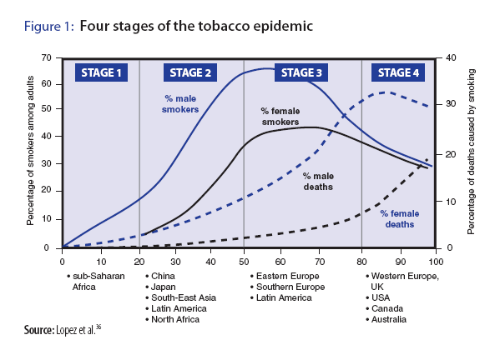
Why invest in Africa now?
Opportunity Map
Four Stages of the Tobacco Epidemic
This slide shows the tobacco epidemic over an entire century.
Tobacco control efforts generally start in the late stages of the epidemic, but we have an opportunity to stop the epidemic from occurring in Africa by starting now, while it is still in Stage 1.
© 2009 Bill & Melinda Gates Foundation | 62
Notes:
62
Africa is the last place on earth for the tobacco-epidemic to occur (other than women in various locations). It we don’t work on stopping the epidemic before it starts, we will have a century of misery, an unprecedented double burden of disease (because of the high rates of infectious diseases), etc. This is a unique opportunity, and if we move fast in Africa we have a chance for significant catalytic change.

