Slide 1
Community Engagement in Smoking Cessation
Steven A. Schroeder, M.D.
Distinguished Professor of Health and Health Care,
Director, Smoking Cessation Leadership Center
University of California San Francisco
Reason S. Reyes, M.P.A.
Director of Technical Assistance
Smoking Cessation Leadership Center
University of California San Francisco
Notes:
Steve – slides 1 to 54, 79-82

Slide 2
Topics for Today
Introduction to SCLC
Facts about smoking
Pharmacotherapy
Telephone quitlines
Examples of innovative local, state, and nationwide initiatives
Free resources
Next steps

Slide 3
Smoking Cessation Leadership Center
Began in 2003 as a Robert Wood Johnson National Program Office with a $10 million grant
Aimed at helping clinicians do a better job intervening with tobacco users
Additional funding from VA, Legacy, ARRA, and SAMHSA
Housed at UCSF

Slide 4
SCLC’s Aim
Help more smokers to try to quit and quit successfully
Change norms among clinicians to make smoking cessation regular practice
Broaden access to cessation tools and resources
Improve coverage for treatment services

Slide 5
SCLC Partners with Many Groups
National associations of clinicians
Place-based partnerships with cities, counties, states
Federal agencies such as VA, SAMHSA, CDC, HRSA

Slide 6
Key Clinician Partnerships
Nurses
Dental Hygienists
Diabetes Educators
Pharmacists
Family Physicians
Emergency Physicians
Physician Assistants
Respiratory Therapists
State Mental Health Program Directors
Anesthesiologists
Surgeons

Slide 7
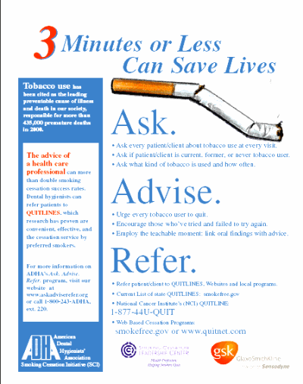
Example: Dental Hygienists
Target (2003): 25-50% of DH intervening by end of year 3
By 2006: 56% of DHs intervened with their patients
“Ask Advise Refer” was born

Slide 8
Key Behavioral Health Partnerships
American Psychiatric Nurses Association (APNA)
Depression and Bipolar Support Alliance (DBSA)
Community Anti-Drug Coalition of America (CADCA)
Faces and Voices of Recovery
National Association of Alcoholism and Drug Abuse Counselors (NAADAC)
National Alliance on Mental Illness (NAMI)
National Association of State Alcohol/Drug Abuse Directors (NASADAD)
National Association of State Mental Health Program Directors (NASMHPD)
The National Council
Mental Health America
University of Colorado Medical School at Denver
Substance Abuse and Mental Health Services Administration (SAMHSA)

Slide 9
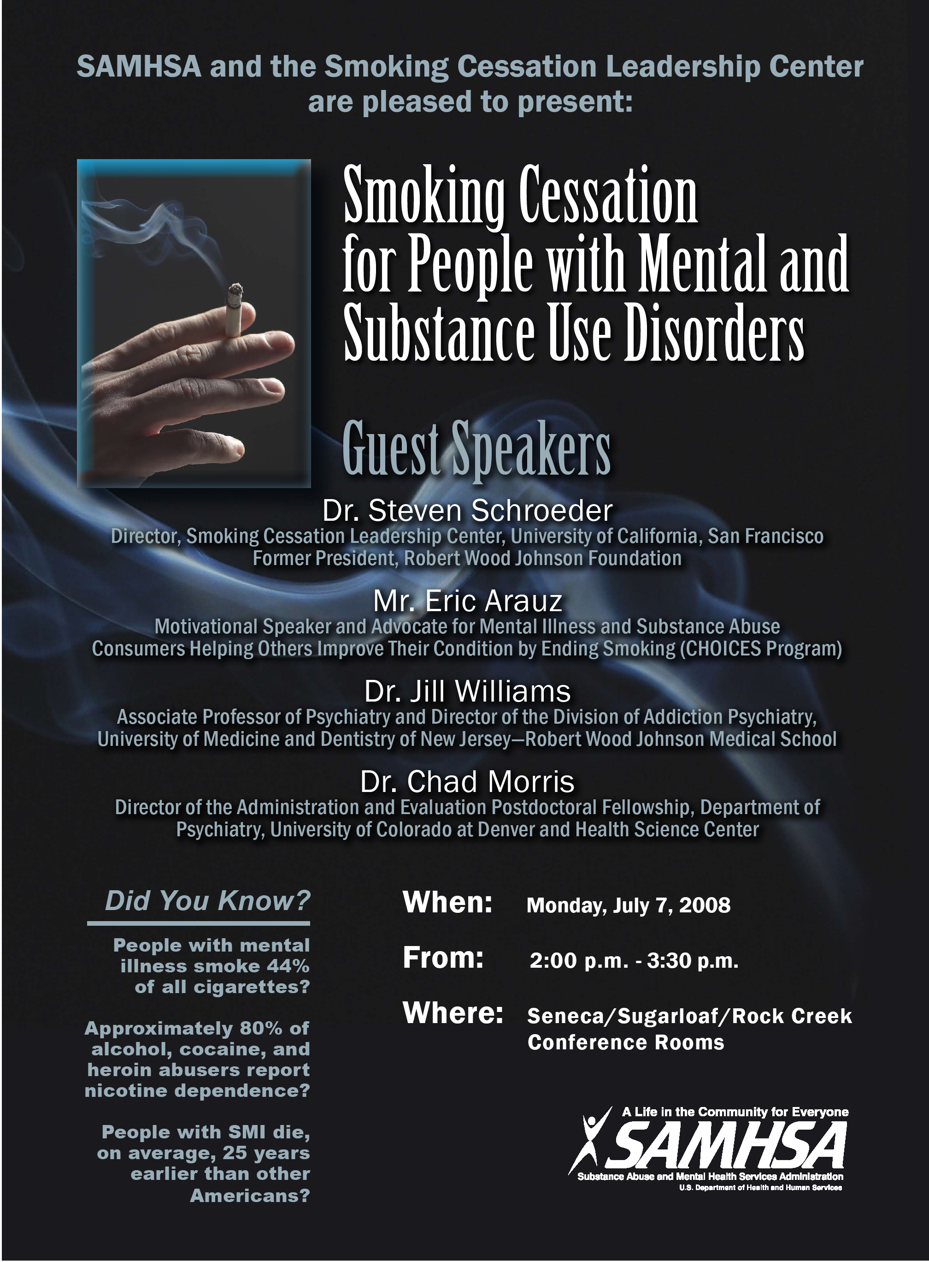
Work with SAMHSA
Created SAMHSA’s Tobacco-Free Initiative
Integrate smoking cessation into its agency’s mission
See later slides by Reason Reyes
In-Service Training Poster: July 7, 2008

Slide 10
HRSA – 2011 Performance Measures
Percentage of patients age 18 years and older who were queried about tobacco use one or more times within 24 months
Percentage of patients age 18 years and older who were counseled by provider to quit smoking

Slide 11
Facts about Smoking
Notes:
Respiratory disease (e.g., COPD) *Pulmonology
Cardiovascular disease (e.g., CHD) *Cardiology
Cancers (e.g., lung, colon, bladder, kidney) *Oncology
Osteoporosis *Orthopedics
Infertility, Pregnancy, Postpartum problems *OB/GYN
Lowers medication blood levels *Psychiatry, others
Prolonged wound healing *Surgery, Infectious Disease
Vision problems (e.g. macular degeneration, cataracts) *Ophthalmology
Pregnant and postpartum women
Smoking while pregnant can cause adverse health complications such as intrauterine growth retardation, low birth weight, congenital malformations, pre-mature births, and fetal mortality¹. Source: USDHHS, 2001
Approximately 20-30% of women continue to smoke for the duration of their pregnancy despite these risks^{1,2}. Source: LeClere et al., 1997; Fingerhut et al., 1990; Husten et al., 1996
Review the following group instructions:
Illustrate to participants the different areas of the body that are hurt by tobacco. Review from the handout the kinds of illnesses that can be caused by smoking.

Slide 12

What is killing the majority of us is not infectious disease, but our chronic and modifiable behaviors
Notes:
More than 1/3 of all U.S. deaths each year are related to smoking, poor eating habits and physical inactivity
(http://seniorjournal.com/NEWS/Health/4-03-10causesofdeath.htm & http://www.fightchronicdisease.org)

Slide 13
Why Community Health Clinics?
Integrated and health home models
Access to high risk populations
Community-based and patient-directed
Complements other prevention and wellness activity
HRSA performance measures
Notes:
Health centers are community-based and patient-directed organizations that serve populations with limited access to health care. These include low income populations, the uninsured, those with limited English proficiency, migrant and seasonal farmworkers, individuals and families experiencing homelessness, and those living in public housing.
Who Health Centers Serve
■People of all ages. Approximately 33 percent of patients in 2009 were children (age 18 and younger); about 7 percent were 65 or older.
■People without and with health insurance. The proportion of uninsured patients of all ages was approximately 38% in 2009, while the number of uninsured patients increased from 4 million in 2001 to over 7.2 million in 2009.
■People of all races and ethnicities. In 2009, 27 percent of health center patients were African-American and 35 percent were Hispanic/Latino--more than twice the proportion of African-Americans and over two times the proportion of Hispanics/Latinos reported in the overall U.S. population.
■Special populations. In 2009, health centers served nearly 865,000 migrant and seasonal farm workers and their families; more than 1 million individuals experiencing homelessness; and more than 165,000 residents of public housing.
HRSA Performance Measures:
-Percentage of patients age 18 years and older who were queried about tobacco use one or more times within 24 months
-Percentage of patients age 18 years and older who were counseled by provider to quit smoking

Slide 14

TRENDS in ADULT SMOKING, by SEX—U.S., 1955–2010
Trends in cigarette current smoking among persons aged 18 or older
19.3% of adults are current smokers
Male
Percent
Female
21.0%
17.8%
Year
70% want to quit
Graph provided by the Centers for Disease Control and Prevention. 1955 Current Population Survey; 1965–2010 NHIS. Estimates since 1992 include some-day smoking.
Notes:
14
This graph demonstrates trends in smoking among adults in the U.S. between 1955 and 2007 (CDC, 1999, 2008). Since 1990, the smoking prevalence among men and women has experienced only a slight decline, compared to previous decades, highlighting a need for enhanced tobacco control efforts. In 2007, results of the National Health Interview Survey (NHIS) indicated that approximately 43.4 million adults (19.8% of the U.S. adult population) are current smokers¹ (CDC, 2008). Of these, 77.8% smoke every day and 22.2% smoke some days (CDC, 2008). A greater proportion of men (22.3%) than women (17.4%) are current smokers.
An estimated 70% of all smokers want to quit completely (CDC, 2002). In 2007, approximately 13.4 million (39.8%) of current smokers stopped smoking at least 1 day during the past 12 months because they were trying to quit (CDC, 2008). In 2007, an estimated 47.3 million adults were former smokers,² representing 52.1% of persons who had ever smoked (CDC, 2008).
♪ Note to instructor(s): Cessation statistics vary depending on factors such as the duration of follow-up, definitions of abstinence, and whether reports of cessation were biologically confirmed. According to the CDC (2002), 4.7% of smokers who had smoked every day or some days during the past year had quit and were able to maintain abstinence for 3–12 months in 2000.
¹Current smokers: persons who reported having smoked 100 or more cigarettes during their lifetime and who smoked every day or some days at the time of the interview.
²Former smokers: persons who reported having smoked 100 or more cigarettes during their lifetime but currently did not smoke.
Centers for Disease Control and Prevention (CDC). (1999). Achievements in public health, 1900–1999: Tobacco use—United States, 1900–1999. MMWR 48:986–993.
Centers for Disease Control and Prevention. (2002). Cigarette smoking among adults—United States, 2000. MMWR 51:642–645.
Centers for Disease Control and Prevention. (2008). Tobacco use among adults—United States, 2007. MMWR 57:1221–1226.
Slide is used with permission, Rx for Change: Clinician-Assisted Tobacco Cessation. Copyright © 1999-2009 The Regents of the University of California. All rights reserved.

Slide 15
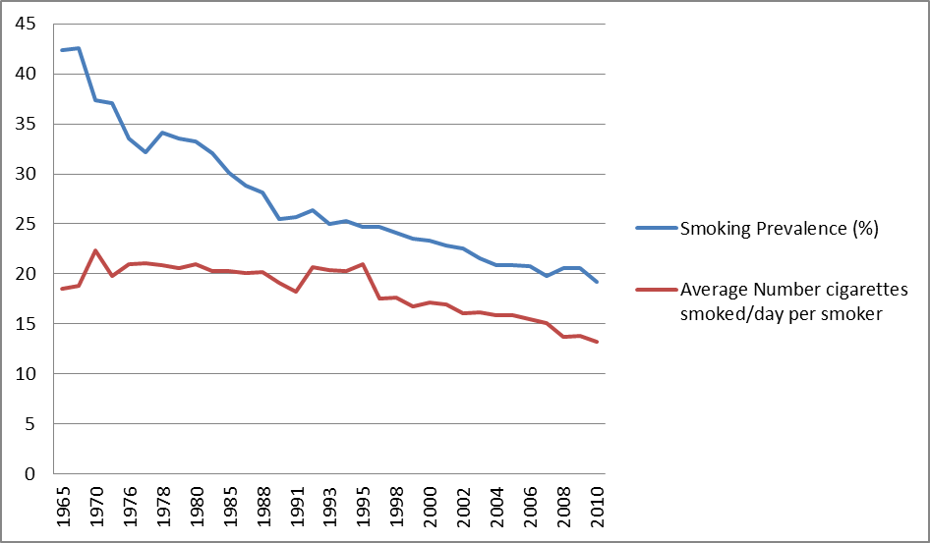
Smoking Prevalence and Average Number of Cigarettes Smoked per Day per Current Smoker 1965-2010
Percent/Number of Cigarettes Smoked Daily
Source: Centers for Disease Control and Prevention (1965-2010). NHIS

Slide 16
Tobacco’s Deadly Toll
443,000 deaths in the U.S. each year
4.8 million deaths world wide each year
10 million deaths estimated by year 2030
50,000 deaths in the U.S. due to second-hand smoke exposure
8.6 million disabled from tobacco in the U.S. alone

Slide 17
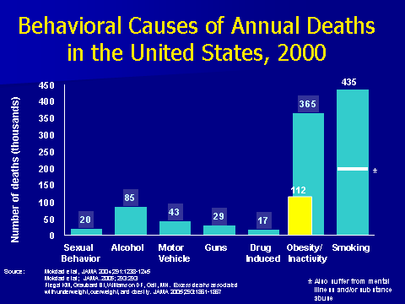
Behavioral Causes of Annual Deaths in the United States, 2000
435
Number of deaths (thousands)
*
*
Sexual Alcohol Motor Guns Drug Obesity/ Smoking
Behavior Vehicle Induced Inactivity
*
Source: Mokdad et al, JAMA 2004; 291:1238-1245
Mokdad et al; JAMA. 2005; 293:293
Also suffer from mental illness and/or substance abuse
17

Slide 18
Annual U.S. Deaths Attributable to Smoking, 2000–2004
Percent of all smoking-attributable deaths
Cardiovascular diseases | 128,497
Lung cancer | 125,522
Respiratory diseases | 103,338
Second-hand smoke | 49,400
Cancers other than lung | 35,326
Other | 1,512
29%
28%
23%
11%
8%
<1%
TOTAL: 443,595 deaths annually
Centers for Disease Control and Prevention. MMWR 2008;571226–1228.
Notes:
Cigarette smoking is the primary known preventable cause of premature death in the U.S. Each year, nearly half a million Americans die from cigarette smoking; one of every five deaths in the U.S. is smoking related (CDC, 2008). This number surpasses the combined death toll due to alcohol, car accidents, suicides, homicides, HIV disease, and illicit drug use.
Average number of years of life lost because of smoking, for male and female smokers (CDC, 2002):
Males 13.2 years
Females 14.5 years
A total of 443,595 annual deaths due to cigarette smoking are reported by the CDC (2008) as follows:
Cardiovascular disease………… 128,497
Ischemic heart disease, other heart diseases, cerebrovascular diseases, atherosclerosis, aortic aneurysm, other circulatory diseases
Lung cancer………………………125,522
Trachea, lung, bronchus (not including lung cancer due to second-hand smoke exposure)
Respiratory diseases…………….103,338
Pneumonia, influenza, bronchitis, emphysema, chronic airway obstruction
Second-hand smoke……………....49,400
Cancers other than lung…………..35,326
Lip, oral cavity, pharynx, esophagus, pancreas, larynx, cervix, uterus, urinary bladder, kidney, other urinary
Other………………………………….1,512
Centers for Disease Control and Prevention. Annual smoking-attributable mortality, years of potential life lost, and productivity losses—United States, 2000–2004. MMWR 2008;57:1126–1128.
Slide is used with permission, Rx for Change: Clinician-Assisted Tobacco Cessation. Copyright © 1999-2009 The Regents of the University of California. All rights reserved.

Slide 19
PREVALENCE of ADULT SMOKING, by RACE/ETHNICITY—U.S., 2009
29.5% Multiple races
23.2% American Indian/Alaska Native*
22.1% White*
21.3% Black*
14.5% Hispanic
12.0% Asian*
* non-Hispanic.
Centers for Disease Control and Prevention (CDC). (2010). MMWR 59:1135–1140.
Notes:
19
In 2005, the prevalence of smoking in the U.S. was highest among American Indian/Alaska Natives (32.0%) and next highest among non-Hispanic Whites (21.9%), followed by non-Hispanic Blacks (21.5%), Hispanics (16.2%), and Asians (13.3%) (CDC, 2006).
Centers for Disease Control and Prevention. (2006). Tobacco use among adults—United States, 2005. MMWR 55:1145–1148.
Slide is used with permission, Rx for Change: Clinician-Assisted Tobacco Cessation. Copyright © 1999-2009 The Regents of the University of California. All rights reserved.

Slide 20
PREVALENCE of ADULT SMOKING, by EDUCATION—U.S., 2009
26.4% No high school diploma
49.1% GED diploma
25.1% High school graduate
23.3% Some college
11.1% Undergraduate degree
5.6% Graduate degree
Centers for Disease Control and Prevention (CDC). (2010). MMWR 59:1135–1140.
Notes:
20
In 2005, the prevalence of current smoking¹ in the U.S. was highest among adults (aged 25 years or older) who had received a General Educational Development (GED) diploma (43.2%). Persons with a graduate degree (masters, professional, or doctorate) had the lowest prevalence (7.1%) (CDC, 2006).
Also notable is the fact that the prevalence of adult smoking is associated with poverty level. The prevalence is 20.6% for persons who are at or above the poverty level and 29.9% for persons who are below the poverty level (CDC, 2006).
The smoking prevalence is 24.4% for persons aged 18–24; 24.1% for persons aged 25–44; 21.9% for persons aged 45–64; and 8.6% for persons at least 65 years of age (CDC, 2006).
¹Current smokers: persons who reported having smoked 100 or more cigarettes during their lifetime and who smoked every day or some days at the time of the interview.
Centers for Disease Control and Prevention. (2006). Tobacco use among adults—United States, 2005. MMWR 55:1145–1148.
Slide is used with permission, Rx for Change: Clinician-Assisted Tobacco Cessation. Copyright © 1999-2009 The Regents of the University of California. All rights reserved.

Slide 21
Smoking and Mental Illness:
The Heavy Burden
200,000 annual deaths from smoking occur among patients with SMI and/or substance abuse
This population consumes 44% of all cigarettes sold in the United States
-- higher prevalence
-- smoke more
-- more likely to smoke down to the butt
People with SMI die on average 25 years earlier than others, and smoking is a large contributor to that early mortality
Social isolation from smoking compounds the social stigma

Slide 22


Youth Targeting
“If our Company is to survive and prosper, over the long term, we must get our share of the youth market.”
      RJ Reynolds planning memorandum 1973
Notes:
As many as 80% of tobacco users start smoking before they are age 18
Adolescent smokers are more likely to report heightened levels of stress, depression, and anxiety
An over twofold risk for suicide attempts for adolescents who smoke >15 cigarettes per day
(Brown et al., 1996; Chassin et al., 1984; Escobedo et al., 1998; Koval et al., 2000; Patton et al., 1996; Pederson et al., 2000; Riala et al., 2007; Sonntag et al., 2000; Stein et al., 1996)

Slide 23
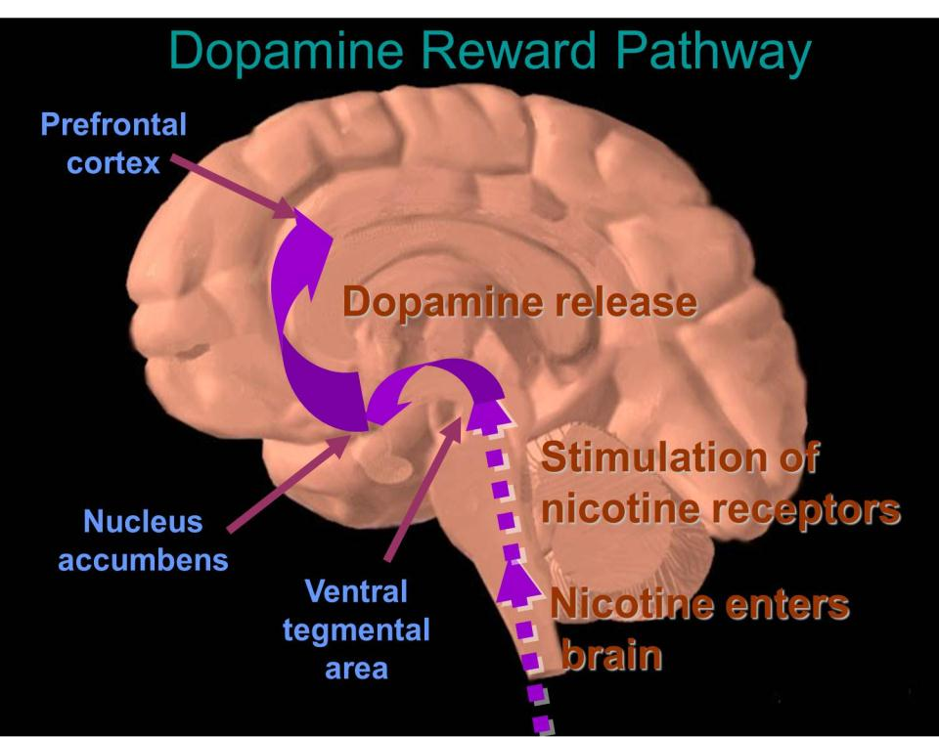
Notes:
Nicotine is the major pharmacologically active alkaloid in tobacco.
Drugs such as cocaine, heroin, amphetamine, and nicotine exert profound effects on the brain. These agents have in common the ability to stimulate the release of the neurotransmitter dopamine in the midbrain. Dopamine induces feelings of euphoria and pleasure and is responsible for activating the dopamine reward pathway (Leshner, 1997).
The dopamine reward pathway, as depicted in this simplified diagram, is a network of nervous tissue in the middle of the brain that elicits feelings of pleasure in response to certain stimuli. The important interconnected structures of the reward pathway include the ventral tegmental area (VTA), the nucleus accumbens, and the prefrontal cortex (area of the brain responsible for thinking and judgment). The neurons of the VTA contain the neurotransmitter dopamine, which is released in the nucleus accumbens and in the prefrontal cortex.
Behaviors that naturally stimulate the reward pathway include eating to relieve hunger, drinking to alleviate thirst, or engaging in sexual activity. On a primitive, neurochemical level, stimulation of the reward pathway reinforces the behavior so that it will be repeated. Obviously these behaviors are necessary for continued survival of the organism. The reward pathway can also be stimulated by drugs of abuse such as cocaine, opiates, amphetamine, and nicotine. When these unnatural stimuli trigger the reward pathway the same pleasurable feelings are elicited. Researchers believe that, with chronic drug use, the brain becomes chemically altered—transforming a drug user into a drug addict (Leshner, 1997).
Consider cigarette smoking as an example. Immediately following inhalation, a bolus of nicotine enters the brain, stimulating the release of dopamine, which induces nearly immediate feelings of pleasure and relief of symptoms of nicotine withdrawal. This rapid dose-response reinforces and perpetuates the smoking behavior.
This slide is made available to the public through the National Institute on Drug Abuse Web page, at http://www.nida.nih.gov/Teaching/largegifs/slide-9.gif. Adapted with permission by Dr. Rochelle D. Schwartz-Bloom, Duke University.
Leshner Al. Drug abuse and addiction are biomedical problems. Hosp Pract (special report) April 1997:2–4.
Nicotine stimulates release of dopamine from nucleus accumbens (brain reward center)
Dopamine enhances feelings of reward and pleasure
Nicotine increases serotonin levels, mostly in the amygdala (brain emotional response center)
Serotonin can relieve depression and anxiety

Slide 24
Nicotine Effects
Receptor Activation
Increase arousal
Heighten attention
Influence stages of sleep
Produce states of pleasure
Decrease fatigue
Decrease anxiety
Reduce pain
Improve cognitive function
Withdrawal Symptoms
Mentally sluggish
Inattentive
Insomnia
Boredom and dysphoria
Fatigue
Anxiety
Increase pain sensitivity
Decrease cognitive function
Most withdrawal symptoms peak 24–48 hr after quitting and subside within 2–4 weeks
24
Notes:
Delivery & Absorption of Nicotine
Nicotine is distilled from burning tobacco and is carried on “tar” droplets and in the vapor phase.
90% of the nicotine is absorbed in the mainstream cigarette smoke.
The lungs present an enormous surface area for the inhaled smoke.
Absorption into the pulmonary circulation results in the rapid delivery of nicotine to the arterial system and from there to the brain.
Nicotine reaches the brain in seconds, contributing to its reinforcing and addictive nature.
The nicotine intake from a single cigarette averages 1 mg (.37 - 1.56).

Slide 25
The Real Culprit
It is the smoke, tar, and additives that make people sicken and die.
Nicotine is dangerous because it leads to addiction, and therefore increased exposure tobacco constituents.
Therefore, nicotine replacement therapy is helpful, not harmful. It is a “clean” form of nicotine.

Slide 26
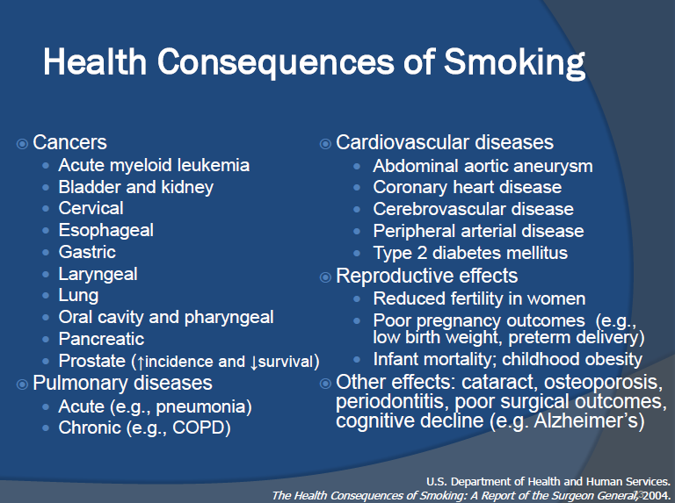

Slide 27
QUITTING: HEALTH BENEFITS
Time Since Quit Date
Circulation improves,
walking becomes easier
Lung function increases up to 30%
Lung cilia regain normal function
Ability to clear lungs of mucus increases
Coughing, fatigue, shortness of breath decrease
2 weeks to
3 months
1 to 9
months
Excess risk of CHD decreases to half that of a continuing smoker
1
year
Risk of stroke is reduced to that of people who have never smoked
Lung cancer death rate drops to half that of a continuing smoker
Risk of cancer of mouth, throat, esophagus, bladder, kidney, pancreas decrease
5
years
10
years
after
15 years
Risk of CHD is similar to that of people who have never smoked
Notes:
The 1990 Surgeon General’s Report on the health benefits of smoking cessation outlines the numerous and substantial health benefits incurred when patients quit smoking (USDHHS, 1990):
Health benefits realized 2 weeks to 3 months after quitting include the following: circulation improves, walking becomes easier, and lung function increases up to 30%.
One to nine months later, lung ciliary function is restored. This improved mucociliary clearance greatly decreases the chance of infection because the lung environment is no longer as conducive to bacterial growth. Consequently, coughing, sinus congestion, fatigue, and shortness of breath decrease. In some patients, coughing might actually increase shortly after quitting. This is because the cilia in pulmonary epithelial cells are functioning “normally” and are more effectively clearing the residual tars and other accumulated components of tobacco smoke.
One year later, excess risk of coronary heart disease (CHD) is decreased to half that of a smoker.
After 5 to 15 years, stroke risk is reduced to a rate similar to that of people who have never smoked.
Ten years after quitting, an individual’s chance of dying of lung cancer is approximately half that of continuing smokers. Additionally, the chance of getting mouth, throat, esophagus, bladder, kidney, or pancreatic cancer is decreased.
Finally, 15 years after quitting, an individual’s risk of CHD is reduced to a rate similar to that of people who have never smoked.
Thus the benefits of quitting are significant. It is never too late to quit to incur many of the benefits of quitting. The next two slides depict some advantages of quitting earlier in life, as opposed to later.
U.S. Department of Health and Human Services (USDHHS). (1990). The Health Benefits of Smoking Cessation. A Report of the Surgeon General (DHHS Publication No. CDC 90-8416). U.S. Department of Health and Human Services, Public Health Service, Centers for Disease Control and Prevention and Health Promotion, Office on Smoking and Health.
Slide is used with permission, Rx for Change: Clinician-Assisted Tobacco Cessation. Copyright © 1999-2009 The Regents of the University of California. All rights reserved.

Slide 28
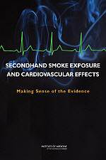
Secondhand Smoke
Nonsmokers who are exposed to secondhand smoke at home or work increase their heart disease risk by 25–30% and their lung cancer risk by 20–30%
http://www.cdc.gov/tobacco/basic_information/health_effects/heart_disease/index.htm

Slide 29
Secondhand Smoke Causes >50,000 Deaths Annually
SHS &
CVD
SHS &
Lung Cancer
Smoking-attributable Annual Deaths

Slide 30
Causal Associations with
Second-Hand Smoke
There is no safe level of second-hand smoke.
Developmental
  Low birthweight
  Sudden infant death syndrome (SIDS)
  Pre-term delivery
  Childhood depression
Respiratory
  Asthma induction and exacerbation
  Eye and nasal irritation
  Bronchitis, pneumonia, otitis media in children
  Decreased hearing in teens
Carcinogenic
  Lung cancer
  Nasal sinus cancer
  Breast cancer (younger, premenopausal women)
Cardiovascular
  Heart disease mortality
  Acute and chronic coronary heart disease morbidity
  Altered vascular properties
USDHHS. (2006). The Health Consequences of Involuntary Exposure to Tobacco Smoke: Report of the Surgeon General.

Slide 31
Assessment,
Treatment Planning, and Continuity of Care
Notes:
Respiratory disease (e.g., COPD) *Pulmonology
Cardiovascular disease (e.g., CHD) *Cardiology
Cancers (e.g., lung, colon, bladder, kidney) *Oncology
Osteoporosis *Orthopedics
Infertility, Pregnancy, Postpartum problems *OB/GYN
Lowers medication blood levels *Psychiatry, others
Prolonged wound healing *Surgery, Infectious Disease
Vision problems (e.g. macular degeneration, cataracts) *Ophthalmology
Pregnant and postpartum women
Smoking while pregnant can cause adverse health complications such as intrauterine growth retardation, low birth weight, congenital malformations, pre-mature births, and fetal mortality¹. Source: USDHHS, 2001
Approximately 20-30% of women continue to smoke for the duration of their pregnancy despite these risks^{1,2}. Source: LeClere et al., 1997; Fingerhut et al., 1990; Husten et al., 1996
Review the following group instructions:
Illustrate to participants the different areas of the body that are hurt by tobacco. Review from the handout the kinds of illnesses that can be caused by smoking.

Slide 32
Physicians Under-treat Smokers*
*AAMC-Legacy survey: Physician behavior and practice patterns related to smoking cessation, 2007.
AAMC survey of 3012 physicians representing FM, GIM, Ob-Gyn, Psych
Only 1% were current smokers
84% asked about smoking
86% advised to quit
31% recommended NRT
17% arranged follow-up
7% referred to quitlines
Notes:
32

Slide 33
Myths About Smoking and Mental Illness*
Tobacco is necessary self-medication (industry has supported this myth)
They are not interested in quitting (same % wish to quit as general population)
They can’t quit (quit rates same or slightly lower than general population)
Quitting worsens recovery from the mental illness (not so; and quitting increases sobriety for alcoholics)
It is a low priority problem (smoking is the biggest killer for those with mental illness or substance abuse issues)
* Prochaska, NEJM, July 21, 2011

Slide 34
Services should be integrated at the point of delivery, actively involve patients as partners in their care, and be coordinated with other community resources
-Colorado Behavioral Health Council, 2010

Slide 35
Tobacco Cessation Works
70% of smokers say they want to quit, 40% of smokers attempt to quit
Quitting tobacco is difficult but absolutely feasible if assistance is provided
  Quit rates with willpower alone – 4%
  Pharmacotherapy (NRT) alone – 22%
  QuitLine counseling plus NRT – 36%
  Chantix – 44%
Smokers are more than twice as likely to quit with coverage

Slide 36
Ways to Help Smokers Quit
Raise prices (taxes)
Clean indoor air
Create counter-marketing
Provide cessation aids: counseling and pharmacotherapy, alone or in combination
  Directly by clinician in individual or group session (office or hospital)
  Toll-free telephone quitline
Notes:
36

Slide 37
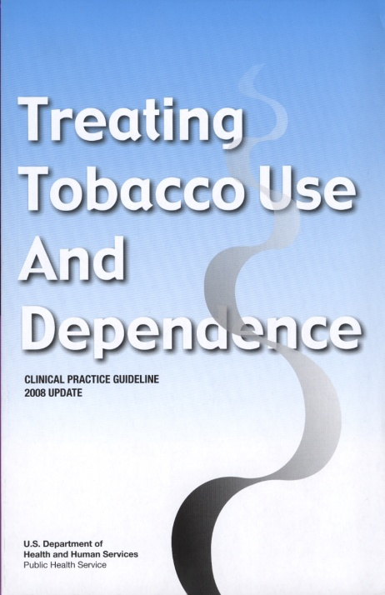
Pharmacotherapy
“Clinicians should encourage all patients attempting to quit to use effective medications for tobacco dependence treatment, except where contraindicated or for specific populations* for which there is insufficient evidence of effectiveness.”
* Includes pregnant women, smokeless tobacco users, light smokers, and adolescents.
Medications significantly improve success rates.
Fiore et al. (2008). Treating Tobacco Use and Dependence: 2008 Update.
Clinical Practice Guideline. Rockville, MD: USDHHS, PHS, May 2008.
Notes:
37
The U.S. Public Health Service Clinical Practice Guideline for treating tobacco use and dependence states that “clinicians should encourage all patients attempting to quit to use effective medications for tobacco dependence treatment, except where contraindicated or for specific populations for which there is insufficient evidence of effectiveness” (Fiore et al., 2008, p. 106).
Use of pharmacotherapy requires special consideration in the following patient populations (Fiore et al., 2008):
Pregnant or breast-feeding women
Smokeless tobacco users
Patients smoking fewer than 10 cigarettes per day (light smokers)
Adolescents
Fiore MC, Jaén CR, Baker TB, et al. (2008). Treating Tobacco Use and Dependence: 2008 Update. Clinical Practice Guideline. Rockville, MD: U.S. Department of Health and Human Services. Public Health Service.
Slide is used with permission, Rx for Change: Clinician-Assisted Tobacco Cessation. Copyright © 1999-2009 The Regents of the University of California. All rights reserved.

Slide 38
Pharmacologic Methods:
First-line Therapies*
Three general classes of FDA-approved medications for smoking cessation:
  Nicotine replacement therapy (NRT)
  -- nicotine gum, patch, lozenge, nasal spray, inhaler
  Partial nicotine receptor agonist
  -- varenicline
  Psychotropics
  -- sustained-release bupropion
    * Counseling plus meds better than either alone
Combination therapy can be used for heavily addicted smokers.
Notes:
There are three general classes of FDA-approved drugs for cessation:
Nicotine replacement therapy (NRT) includes the nicotine gum, patch, lozenge, nasal spray, and inhaler. A nicotine sublingual tablet currently is available in Europe.
The only psychotropic agent currently approved by the FDA for smoking cessation is bupropion SR.
Varenicline, a partial nicotinic receptor agonist, was approved by the FDA in 2006 for smoking cessation.
According to the U.S. Public Health Service Clinical Practice Guideline for treating tobacco use and dependence, NRT, sustained-release bupropion and varenicline are considered first-line pharmacotherapies for smoking cessation (Fiore et al., 2008). Currently, no medications have an FDA indication for use in spit tobacco cessation.
♪ Note to instructor(s): The following pharmacotherapies have been studied but are not recommended by the U.S. Public Health Service Clinical Practice Guideline for treating tobacco use and dependence based on a lack of benefit relative to placebo therapy (David et al., 2006; Fiore et al., 2008; Hughes et al., 2007):
Anxiolytic agents (buspirone, diazepam)
Beta-blockers (propranolol)
Mecamylamine
Opioid antagonists (buprenorphine, naloxone, naltrexone)
Selective serotonin reuptake inhibitors (citalopram, fluoxetine, paroxetine, sertraline)
Silver acetate
David S, Lancaster T, Stead LF, Evins AE. (2006). Opioid antagonists for smoking cessation. Cochrane Database Syst Rev 4:CD003086.
Fiore MC, Jaén CR, Baker TB, et al. (2008). Treating Tobacco Use and Dependence: 2008 Update. Clinical Practice Guideline. Rockville, MD: U.S. Department of Health and Human Services. Public Health Service.
Hughes JR, Stead LF, Lancaster T. (2007). Antidepressants for smoking cessation. Cochrane Database Syst Rev 1:CD000031.
Slide is used with permission, Rx for Change: Clinician-Assisted Tobacco Cessation. Copyright © 1999-2009 The Regents of the University of California. All rights reserved.

Slide 39
Caveats About Cessation Literature
Smoking should be thought of as a chronic condition, yet drug treatment often short (12 weeks) in contrast to methadone maintenance
Great spectrum of severity and addiction; treatment should be tailored accordingly
Volunteers for studies likely to be more motivated to quit
Placebo and drug groups tend to have more intensive counseling than found in real practice world
Most drug trials exclude patients with mental illness

Slide 40
LONG-TERM (≥6 month) QUIT RATES for AVAILABLE CESSATION MEDICATIONS
23.9
20.2
18.0
19.0
15.8
16.1
17.1
Percent quit
11.3
11.8
11.2
10.3
9.9
8.1
9.1
Data adapted from Cahill et al. (2008). Cochrane Database Syst Rev; Stead et al. (2008).
Cochrane Database Syst Rev; Hughes et al. (2007). Cochrane Database Syst Rev
Notes:
40
This bar chart summarizes the long-term (≥6-month) quit rates observed with the different NRT products, bupropion SR and varenicline (Cahill et al., 2008; Stead et al., 2008; Hughes et al., 2007). These data derive from 145 different randomized-controlled trials; therefore, it is inappropriate to compare the active medications with respect to clinical efficacy. What this chart does illustrate, however, is that the quit rates from each of the methods is approximately twice that of its corresponding placebo control treatment arm.
Each of the pharmacotherapy options depicted in the chart is considered effective. When patients ask for assistance with their quit attempt, any product can be recommended, if not contraindicated. However, when assisting patients in choosing a product, clinicians should consider additional factors. The number of cigarettes smoked per day (or time to first cigarette, for the nicotine lozenge), level of dependence, advantages and disadvantages of each product, methods used for prior quit attempts and reasons for relapse, and the patient’s own product preference need to be considered. Behavioral counseling should be used in conjunction with all pharmacologic therapies.
Cahill K, Stead LF, Lancaster T. Nicotine receptor partial agonists for smoking cessation. (2008). Cochrane Database Syst Rev 3:CD006103.
Hughes JR, Stead LF, Lancaster. (2007). Antidepressants for smoking cessation. Cochrane Database Syst Rev 4:CD000031.
Stead LF, Perera R, Bullen C, Mant D, Lancaster T. (2008). Nicotine replacement therapy for smoking cessation. Cochrane Database Syst Rev 1:CD000146.
Slide is used with permission, Rx for Change: Clinician-Assisted Tobacco Cessation. Copyright © 1999-2009 The Regents of the University of California. All rights reserved.

Slide 41

NRT Patches
Nicoderm CQ:
Recommended doses for 10+ cigs/day (if less than 10 cigarettes per day consider other NRT or start with patch at 14mg/day)
Patch strength Duration
21 mg/day 6-8 weeks
14 mg/day 2-4 weeks
7 mg/day 2-4 weeks
Nicotrol:
15 mg/16 hours 8 weeks
Notes:
Decreases nicotine withdrawal symptoms
Lessens negative mood states in early abstinence
No interactions with other psychiatric medications
No effect on psychiatric medication blood levels
Safe in presence of C-V disease (do not use within 2 weeks of MI, serious arrythmia or severe/worsening angina)
Safe with concomitant smoking—harm reduction

Slide 42
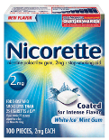
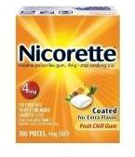

Nicotine Gum
Sugar-free chewing gum
Absorbed through the lining of the mouth
Available in two strengths (2mg and 4mg)
Available flavors are:
  Original, cinnamon, fruit, mint (various), and orange
Sold without a prescription as Nicorette or as a generic
Some find the gum difficult to chew
May not be a good choice for people with jaw problems, braces, retainers, or significant dental work
Nicorette gum (shown here) is manufactured by GlaxoSmithKline.
Courtesy of the University of California, San Francisco
Notes:
Available strengths: 2mg, 4mg (starting strength depends on number of cigarettes smoked per day)
Description of Product
Nicotine gum was the first nicotine-containing medication on the market. The nicotine from the gum is absorbed across the lining of the mouth. The gum is provided in a sugar-free form. Some people may find the gum difficult to chew and is not an ideal choice for people with jaw problems, braces, retainers, or significant dental work. Newer, softer to chew flavors of Nicorette are now available. The gum is available in brand name and as a generic.
The gum significantly improves quit rates compared to placebo.
Fiore MC et al. (2008). Treating Tobacco Use and Dependence: 2008 Update. Rockville, MD: U.S. Department of Health and Human Services, Public Health Service.
Scheduled dosing increases success with this treatment
<25 cigarettes per day: 2mg gum q 1 to 2 hours, tddnte 24 pieces
>25 cigarettes per day: 4 mg gum, as above
Slowly taper dosing as tolerated over 8 to 12 weeks
Chewing technique: chew gum slowly until peppery/minty taste emerges and then park between cheek and gum
Note: Acidic beverages will interfere with absorption, so no food/juices/sodas 15 minutes prior to use and during use
Side Effects: mouth soreness, hiccups, dyspepsia and jaw ache

Slide 43
Bupropion SR Tablets
Does not contain nicotine
Tablet that is swallowed whole, and the medication is released over time
Same medication as Wellbutrin, which is used to treat depression
Sold with a prescription
Courtesy of the University of California, San Francisco
43

Slide 44
VARENICLINE:
Advantages and Disadvantages
Advantages
  Varenicline is an oral formulation with twice-a-day dosing
  Varenicline offers a new mechanism of action for persons who previously failed using other medications
  Early industry-sponsored trials suggest this agent is superior to bupropion SR
Disadvantages
  Nausea in up to 1/3 of patients
  Avoid in chronic renal failure
  Post-marketing surveillance data just emerging
  New warnings about rare but important psychiatric symptoms; hard to distinguish from nicotine withdrawal; 100 reported suicides since 2006
  Increase in cardiac events (of uncertain significance)
Notes:
Advantages of varenicline include the following:
Varenicline is an oral formulation (twice-a-day dosing) that is easy to use.
Varenicline offers a new mechanism of action for persons who previously failed using other medications.
Early industry-sponsored trials suggest this agent is superior to bupropion SR.
Disadvantages of varenicline include the following:
The drug may induce nausea in up to one third of patients.
Slide is used with permission, Rx for Change: Clinician-Assisted Tobacco Cessation. Copyright © 1999-2009 The Regents of the University of California. All rights reserved.

Slide 45
VARENICLINE: Warning
In 2008, Pfizer added warning label advising patients and caregivers:
  Patients should stop taking varenicline and contact their healthcare provider immediately if agitation, depressed mood, or changes in behavior not typical for them are observed, or if patient develops suicidal ideation or thoughts.
In July 2009 this was made into a black box warning for both varenicline (Chantix) and bupropion (Zyban)
In 2011 FDA added additional warning about possible increased risk of heart conditions (MI and other complications) in patients with heart conditions taking varenicline, and asked for additional studies.
Notes:
45
Post marketing, there have been case reports of neuropsychiatric symptoms (behavior changes, agitation, depressed mood, suicidal ideation or behavior) as well as reports of worsening of pre-existing psychiatric illness among patients being treated with varenicline. These reports are rare in comparison to the total number of patients using the medication, but nonetheless warrant ongoing surveillance. In 2008, the FDA alerted heath-care providers to advise patients and caregivers that patients should stop taking varenicline and contact their health-care provider immediately if agitation, depressed mood, or changes in behavior that are not typical for them are observed, or if the patient develops suicidal ideation or suicidal behavior (FDA, 2008). Clinicians should also be aware that patients with serious psychiatric illness such as schizophrenia, bipolar disorder, and major depressive disorder did not participate in the pre-marketing studies of varenicline, and as such the safety and efficacy of the medications in these populations have not been established (Pfizer, 2008).
Pfizer, Inc. (2008, May). Chantix Package Insert. New York, NY.
FDA, Center for Drug Evaluation and Research. (2008). Information for Healthcare Professionals Varenicline (marketed as Chantix). Retrieved September 12, 2008, from http://www.fda.gov/cder/drug/InfoSheets/HCP/vareniclineHCP.htm.
Slide is used with permission, Rx for Change: Clinician-Assisted Tobacco Cessation. Copyright © 1999-2009 The Regents of the University of California. All rights reserved.

Slide 46
Combination Therapy
Combination NRT
  Long-acting formulation (patch)
    Produces relatively constant levels of nicotine
  PLUS
  Short-acting formulation (gum, lozenge, inhaler, nasal spray)
    Allows for acute dose titration as needed for withdrawal symptoms
Bupropion SR + NRT
The safety and efficacy of combination of varenicline with NRT or bupropion has not been established.
  Because many of the remaining smokers are very addicted, use of combination therapies is becoming normalized.
Notes:
Data from randomized, controlled trials suggest that certain combinations of first-line cessation medications are efficacious in promoting long-term abstinence. As such, the 2008 Clinical Practice Guideline considers the following regimens to be appropriate first-line therapy in patients attempting to quit smoking (Fiore et al., 2008):
Combination NRT
Combination NRT involves the use of a long-acting formulation (patch) in combination with a short-acting formulation (gum, lozenge, inhaler, or nasal spray). The long-acting formulation, which delivers relatively constant levels of drug, is used to prevent the onset of severe withdrawal symptoms, and the short-acting formulation, which delivers nicotine at a faster rate, is used as needed to control withdrawal symptoms that may occur during potential relapse situations (e.g., after meals, when under stress, or when around other smokers). A recent meta-analysis found that the nicotine patch in combination with a short-acting NRT formulation (gum, inhaler, or nasal spray) was significantly more effective than single-agent NRT. The odds of long-term (≥6 months) cessation were 1.4 with combination therapy compared to monotherapy (95% CI, 1.1-1.6) (Stead et al., 2008).
NRT and Bupropion SR Combination Therapy
Combination therapy with bupropion SR and NRT has been evaluated in three long-term controlled trials. Patients receiving combination therapy in standard dosages were significantly more likely to quit than were patients randomized to the nicotine patch alone. The odds of long term (≥6 months) abstinence were 1.3 with the combination compared to nicotine patch monotherapy (95% CI, 1.0-1.8) (Fiore et al., 2008).
Relative Effectiveness of Medication Combinations (Fiore et al., 2008)
♪ Note to instructor(s): While alternative combinations of NRT (e.g., lozenge + patch, other combinations of short-acting NRT) are theoretically, safe and effective, there are insufficient data to recommend these combinations as first-line treatment. Furthermore, the safety and effectiveness of varenicline in combination with bupropion SR or NRT has not be established. In a small study (n=39 subjects) evaluating varenicline (1 mg bid) in combination with the nicotine patch (21 mg/day) for up to 12 days the incidence of nausea, headache, vomiting, dizziness, dyspepsia and fatigue were greater for the combination when compared to the patch alone. Patients receiving the combination were six times as likely to prematurely discontinue treatment due to adverse events compared to those taking NRT monotherapy (Pfizer, 2008).
Fiore MC, Jaén CR, Baker TB, et al. (2008). Treating Tobacco Use and Dependence: 2008 Update. Clinical Practice Guideline. Rockville, MD: U.S. Department of Health and Human Services. Public Health Service.
Pfizer, Inc. (2008, May). Chantix Package Insert. New York, NY.
Stead LF, Perera R, Bullen C, Mant D, Lancaster T. (2008). Nicotine replacement therapy for smoking cessation. Cochrane Database Syst Rev 1:CD000146.

Slide 47
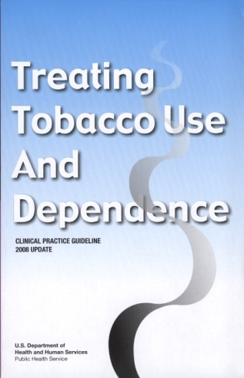
The 5 A’s: Review
ASK
about tobacco USE
ADVISE
tobacco users to QUIT
ASSESS
readiness to make a QUIT attempt
ASSIST
with the QUIT ATTEMPT
ARRANGE
FOLLOW-UP care
Fiore et al. (2008). Treating Tobacco Use and Dependence: 2008 Update.
Clinical Practice Guideline. Rockville, MD: USDHHS, PHS, May 2008.
Notes:
47
As a final review, the 5 A’s are
Ask about tobacco use.
Advise tobacco users to quit.
Assess readiness make a quit attempt.
Assist with the quit attempt.
Arrange follow-up care.
Each of these is a key component of comprehensive tobacco cessation counseling interventions.
Slide is used with permission, Rx for Change: Clinician-Assisted Tobacco Cessation. Copyright © 1999-2009 The Regents of the University of California. All rights reserved.
Slide is used with permission, Rx for Change: Clinician-Assisted Tobacco Cessation. Copyright © 1999-2007 The Regents of the University of California, University of Southern California, and Western University of Health Sciences. All rights reserved.

Slide 48
Ask. Advise. Refer. = 5 A’s
Ask
Advise
Ask. Every patient/client about tobacco use.
Assess
Assist
Advise. Every tobacco user to quit.
Arrange
Refer. Determine willingness to quit. Provide information on quitlines.
Refer to Quitlines
ADHA Smoking Cessation Initiative (SCI)
Notes:
How many of you know about the brief intervention model Ask Advise Refer? The phrase was actually coined at the ADHA summit. As I mentioned, Dr. Schroeder was enthusiastic about the efficacy around quitlines. He introduced quitlines to the folks at the ADHA summit. When presented the facts around quitlines, they immediately chose to incorporate them into their practice by creating a brief intervention called Ask Advise Refer, in fact they coined the term! The quitline counselor takes the rest of the A’s.

Slide 49
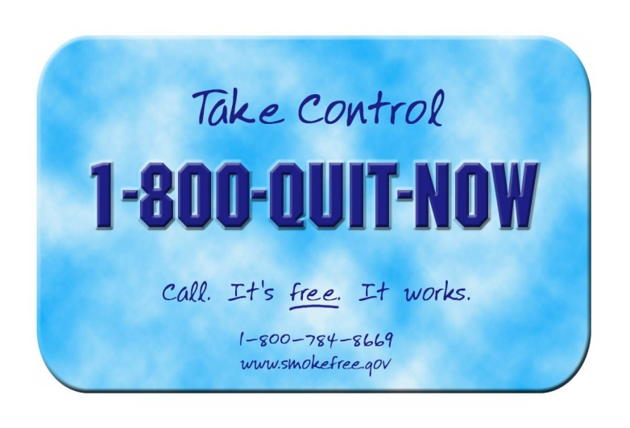
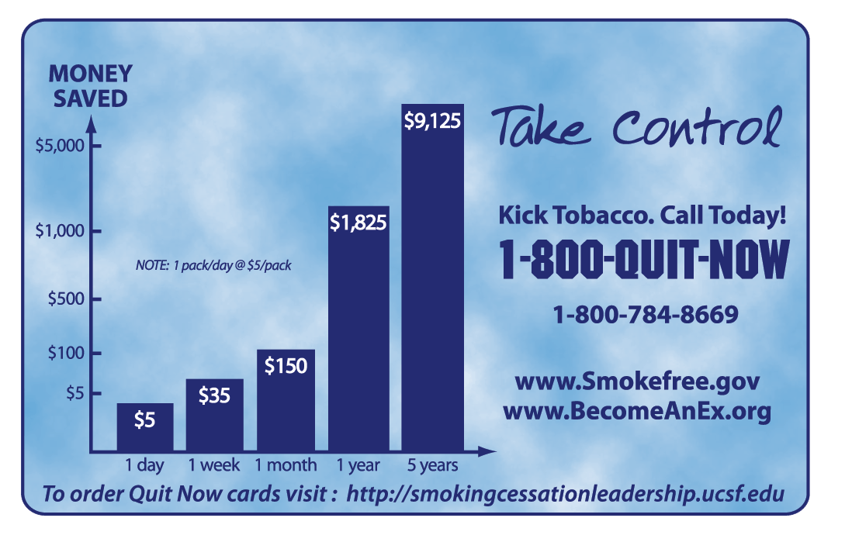
Why the Focus on Quitlines?
They work--calling a quitline can more than double the chance of successfully quitting
Many clinicians say the 5 A’s are too complicated and time-consuming
Most clinicians unaware of quitlines; when they learn about them they are willing to refer smokers to them

Slide 50

The National Card
Tobacco cessation counseling, provided at no cost via telephone to all Americans
Staffed by trained specialists
Up to 4–6 personalized sessions (varies by state)
Some state quitlines offer nicotine replacement therapy at no cost (or reduced cost)
Up to 30% success rate for patients who complete sessions
Notes:
Include recent NAQC report about states utilizing 3%?

Slide 51
Clinic Checklist
Do intake forms include charting smoking status or is there another mechanism for charting smoking status?
Are tobacco use assessments included in client visits?
Does the intake form provide space for updating information during subsequent patient visits?
Is tobacco cessation listed on the treatment plan?
Is there a current copy of specific resources/ referrals available to all staff?
Are there patient educational materials readily available (& in non-English languages)?
Are prescribing guidelines for cessation available to clinicians?
www.tobaccofreealliance.org
Notes:
Assess tobacco use & weight as part of normal assessment & screening procedures
Add tobacco cessation and weight control to treatment plans
Provide educational materials
Incorporate these topics into extant individual, group, and peer interventions

Slide 52
If Ready to Quit
Number of cigarettes smoked per day
Previous quit attempt?
Withdrawal symptoms?
Worries about cessation?
Strategies to quit smoking
Advise setting a quit date
When is the first cigarette smoked?
Refer to the helpline and other cessation resources
Offer an appointment or telephone call 1-2 weeks after the quit date
Recommend/prescribe nicotine replacement therapy or other medications
Tremblay, Cournoyer & O’Loughlin, 2009

Slide 53
If Not Ready to Quit
Discuss the effects of smoking on health
Pros and cons of smoking?
Pros and cons of quitting?
Express concerns about their smoking
Advise to stop smoking
Discuss the effects of secondhand smoke on health of children, relatives, and friends
Offer an appointment specifically to discuss quitting
Tremblay, Cournoyer & O’Loughlin, 2009

Slide 54
Tips for Your Office
Referral forms to the quitline (1-800-QUITNOW)
Carbon monoxide breathalyzer (cost about $500 plus disposal mouthpieces)
One key question to ask: “When do you have your first cigarette of the day?”
Approach smoking as a chronic illness

Slide 55
COMMUNITY PARTNERSHIPS
Innovative Local, State, and National

Slide 56
The Performance Partnership Model
Partnership organized around a specific, measurable result
Part of Reinventing Government
Based on experience in Oregon
Used around the nation and world with good results
Notes:
Originated during the Clinton-Gore years

Slide 57
Answers 4 Questions
Where are we now?
  (baseline)
Where do we want to be?
  (target)
How will we get there?
  (multiple strategies)
How will we know we are getting there?
  (measures)
Notes:
Devise a measurement strategy
Both process and outcome measures are needed
If measures are moving in the wrong direction, regroup and rethink strategies
Publicize progress to keep partners involved

Slide 58
SAMHSA-SCLC State Leadership Academies for Wellness and Smoking Cessation
7 states selected and supported with technical assistance – NY, AZ, OK, MD, NC, TX, AR
Goal: reduce smoking prevalence among behavioral health populations
Bring together behavioral health, public health, and tobacco control fields
Notes:
New York State - pilot state, launched November 2010 in Albany, NY. Promising momentum already.
Other states: AZ, OK, MD, NC, TX, AR – all moving forward
Conduct one- to two-day leadership academy summits and produce action plans
SCLC staff provide in-kind technical assistance, with support from SAMHSA

Slide 59
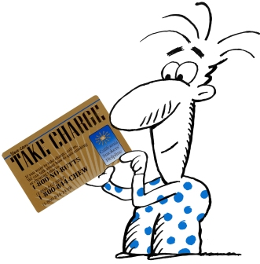


State Initiative Example
Do you CAARD?
California Diabetic Educators – Be Proactive Campaign
Ask: every patient “do you smoke?”
Advise: them to quit
Refer: to the Smokers Helpline. Give them the Gold Card
1. Where are we now? 44% of diabetes educators refer patients who smoke to the quitline
2. Where do we want to be? Increase percentage of diabetes educators who refer smokers to the quitlline to 75%
Notes:
Campaign challenges Diabetes Educators to use the Ask, Advise, Refer intervention and give the California Smokers’ Helpline “Take Charge” Gold Card to patients with diabetes who smoke.
There are over 23 million people diagnosed with diabetes nationally; 1 in 6 adults with diabetes smokes. Smoking increases insulin resistance and risk for diabetes related complications. Evidence suggests that smoking may be an independent risk factor for type 2 diabetes. A health care provider’s advice and use of tobacco cessation quitlines can more than double a smoker’s chance of quitting. However, less than half of smokers are advised to quit and smokers with diabetes are less likely to receive intervention. Diabetes educators play a key role in helping patients learn to manage their diabetes and improve their health. A taskforce of educators was formed to promote tobacco cessation awareness among diabetes educators and health care providers throughout the state.

Slide 60

Do You CAARD? (2)
3. How will we get there? Multifaceted awareness campaign on Ask Advise Refer and the California Smokers’ Helpline
  Strategies:
  Create web presence, educate colleagues, CE program, toolkit, pocket guide
4. How will we know we are getting there?
  3 surveys
  # of CEU presentations
  # of materials ordered
  Helpline data , calls from smokers with diabetes
Notes:
The Performance Partnership model brings together traditional and non-traditional partners who share resources and expertise to achieve a measurable outcome. Partners create strategies following a four- question framework:
There are over 23 million people diagnosed with diabetes nationally; 1 in 6 adults with diabetes smokes. Smoking increases insulin resistance and risk for diabetes related complications. Evidence suggests that smoking may be an independent risk factor for type 2 diabetes. A health care provider’s advice and use of tobacco cessation quitlines can more than double a smoker’s chance of quitting. However, less than half of smokers are advised to quit and smokers with diabetes are less likely to receive intervention. Diabetes educators play a key role in helping patients learn to manage their diabetes and improve their health. A taskforce of educators was formed to promote tobacco cessation awareness among diabetes educators and health care providers throughout the state.

Slide 61
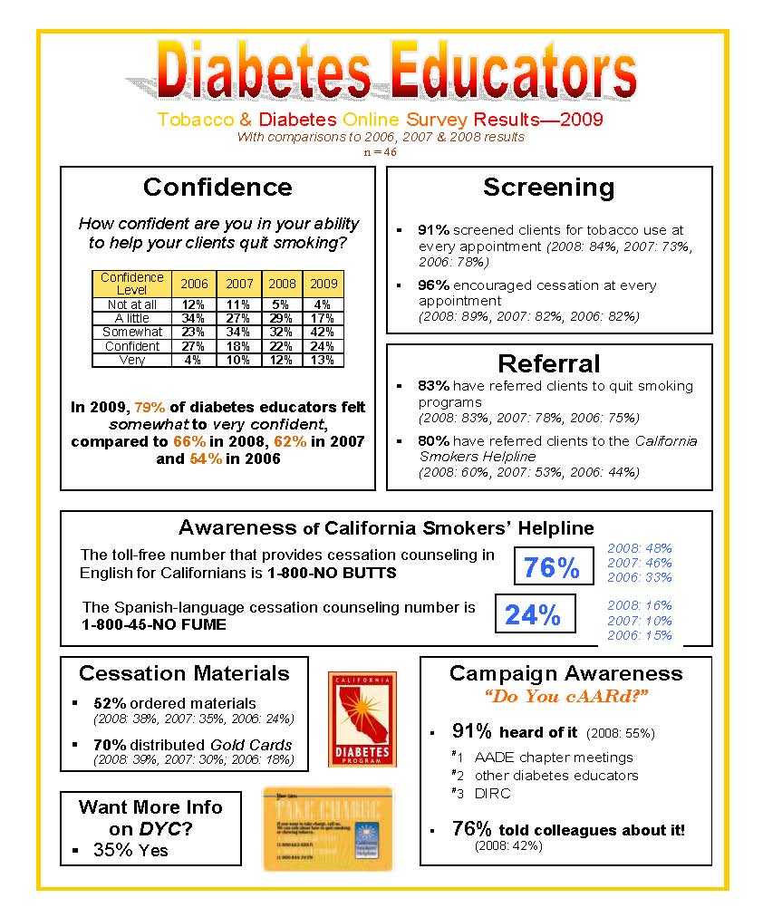
RESULTS
Quitline referrals increased 44-80% in 3 years

Slide 62

County-Level: It’s Quitting Time, LA!
Help 200,000 (out of a million) smokers quit over 3 years in LA County
2010 -- LA 14.3%, among the lowest smoking rates of any US metropolitan area

Slide 63
The VA Project
3 year grant from VA to SCLC
Aim was to promote quitlines within VA
2 pilot hospitals
32 facilities distributed cards, used posters, card holders for patients and providers
400,000 cards distributed to over 158 facilities by end of campaign
Notes:
Since 2006

Slide 64
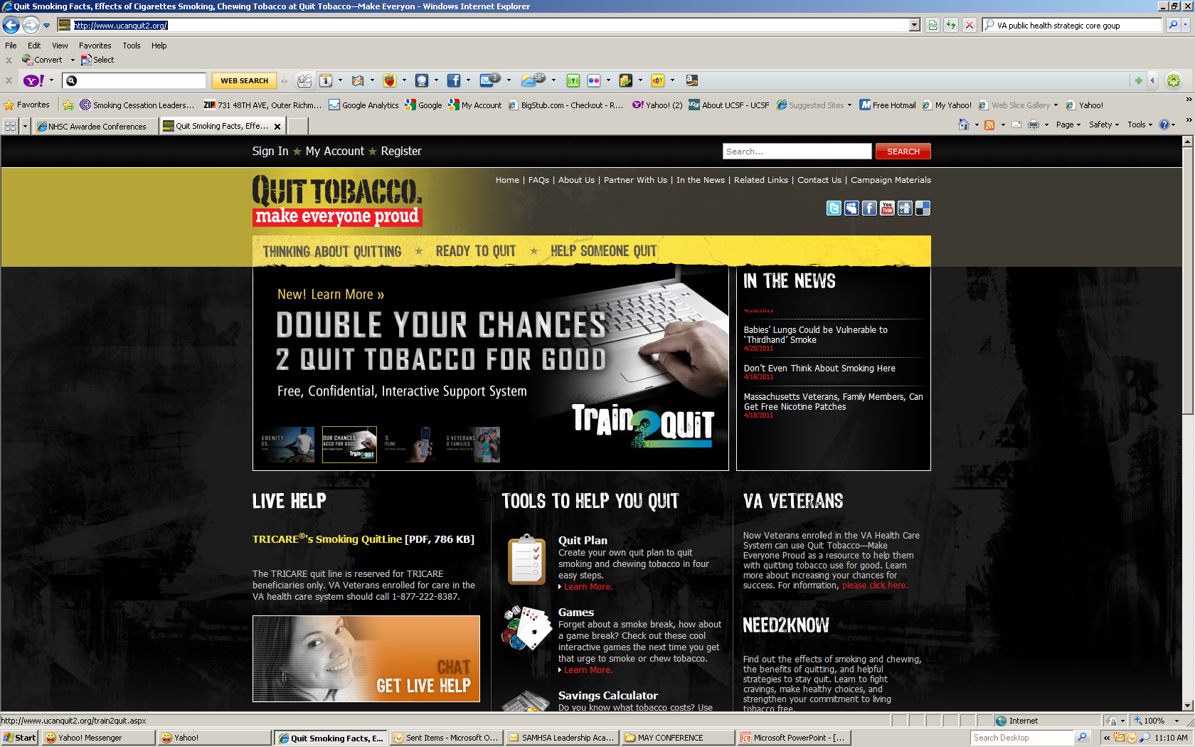
VA and the DoD
US Dept of Defense and the VA collaborated to provide veterans and active military with comprehensive tobacco cessation support
  http://www.ucanquit2.org
Project UNIFORM
  projectuniform.org
Notes:
The U.S. Department of Defense (DoD) and the U.S. Department of Veterans Affairs (VA) are collaborating to provide VA Veterans enrolled for care in the VA health care system with comprehensive tobacco cessation support. Through the website, you can access proven quit techniques and tools to help you quit and stay tobacco-free.
TRICARE is the health care program for Uniformed Service members, retirees and their families worldwide

Slide 65
Low-Cost, No-Cost Resources
Notes:
How or How to Guide

Slide 66
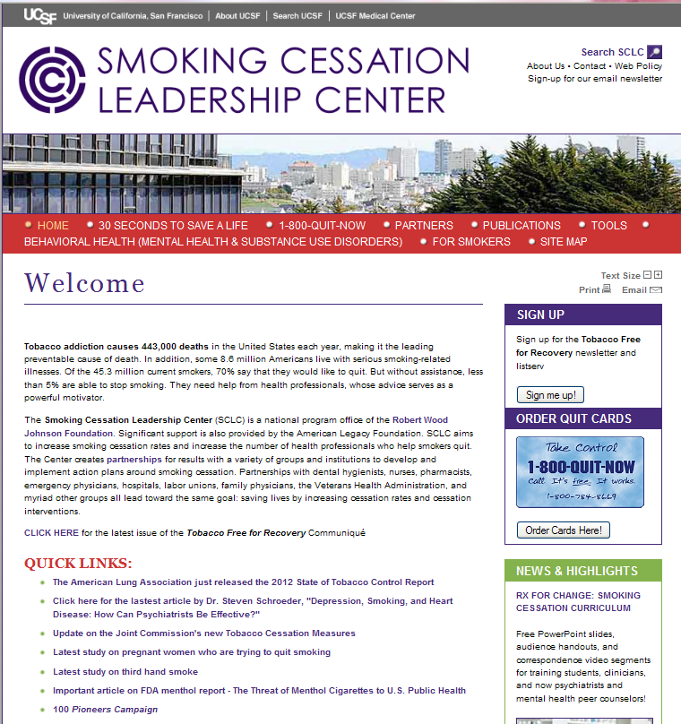
SCLC
Website
http://smokingcessationleadership.ucsf.edu

Slide 67

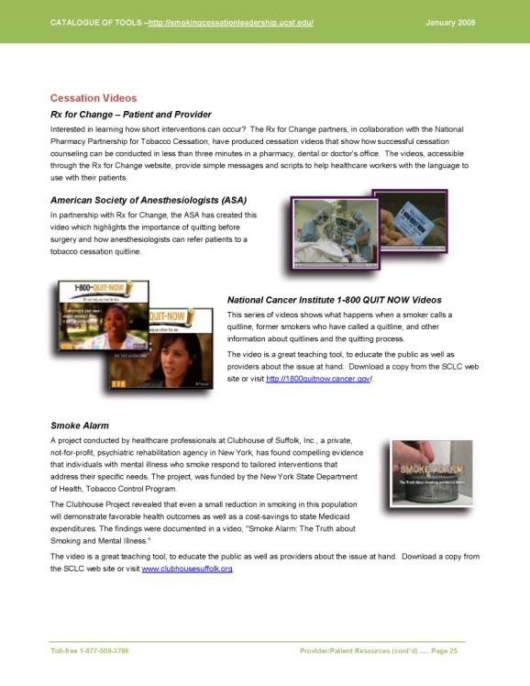
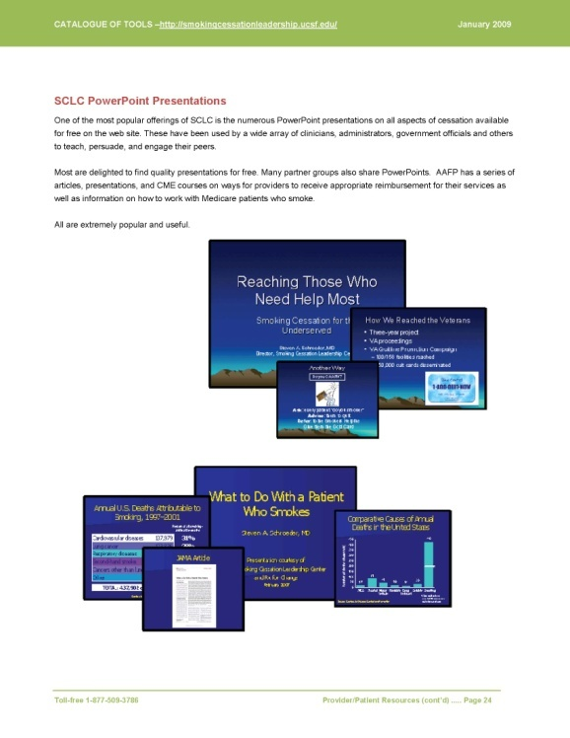
Tools and Resources
free

Slide 68
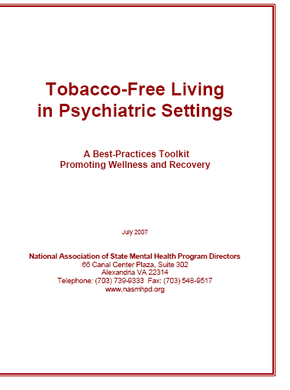

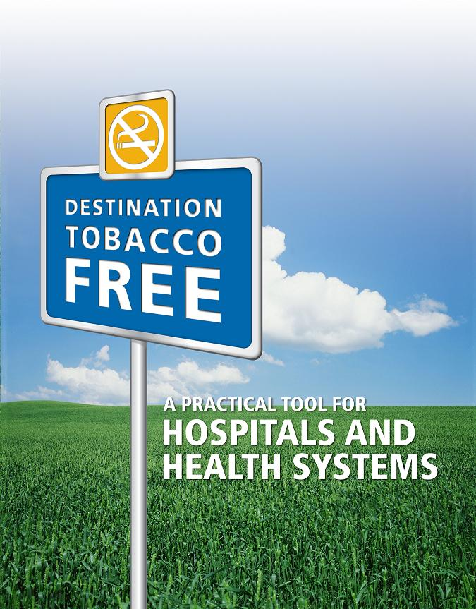
Free Toolkits
Notes:
Developed technical assistance tool kit addressing how to implement smoking cessation in psychiatric hospital settings
Featured smoking cessation as a plenary topic during its recent National Summit of State Psychiatric Hospital Superintendents
Promoted 1-800-QUIT NOW

Slide 69

Toolkits Tailored to Different Behavioral Health Populations

Slide 70
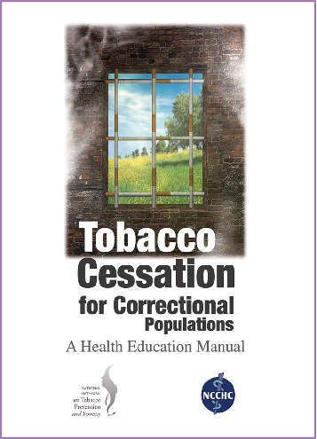
Correctional Populations
Partnership with Break-Free Alliance
Reduce tobacco use among incarcerated
https://app.etapestry.com/cart/HealthEducationCouncil/default/item.php?ref=1219.0.95175773

Slide 71
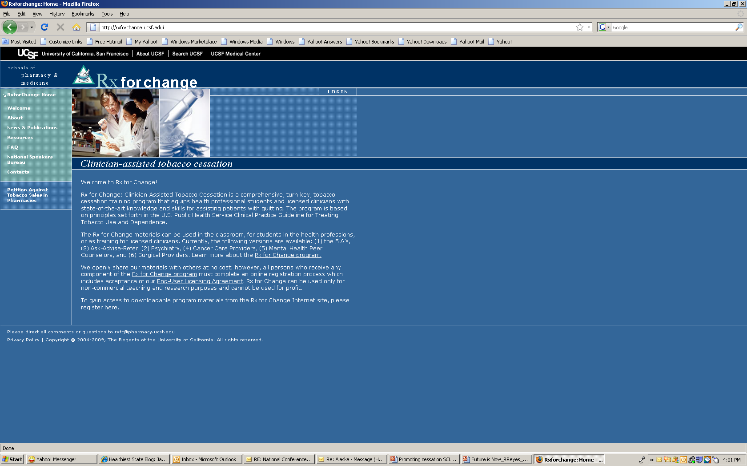
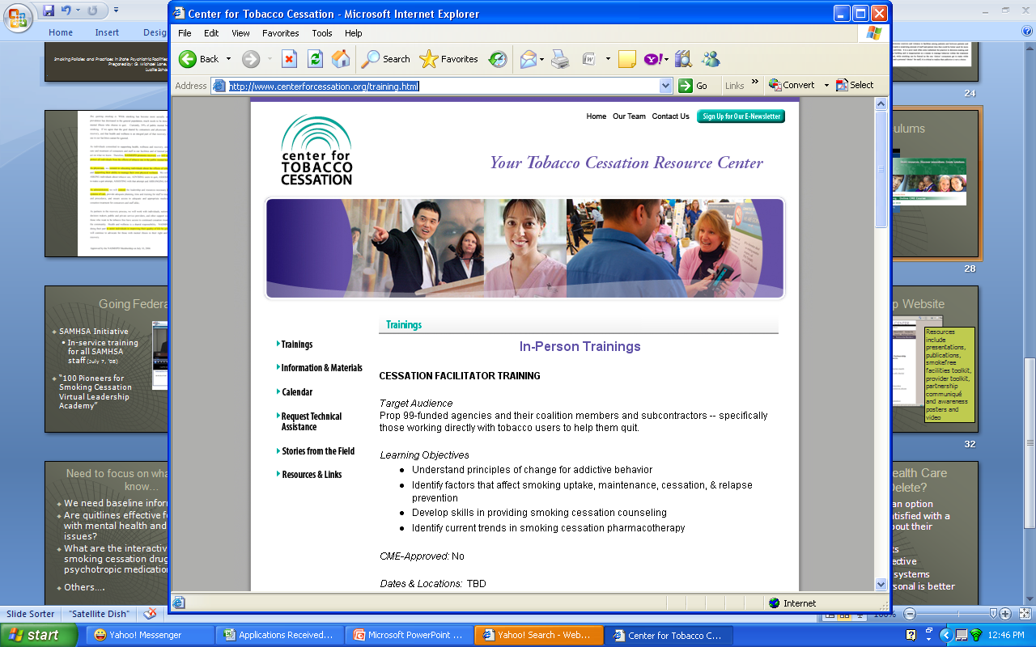

Available Curricula
Notes:
Rx for Change: Clinician-Assisted Tobacco Cessation was designed to address an identified need to enhance the tobacco cessation education of health professionals.
from the Clinical Practice Guideline for Treating Tobacco Use and Dependence, is a comprehensive, turn-key program for training students and licensed clinicians in virtually any health professional field. Tobacco Cessation (“5 A’s” approach)
Our complete curriculum, including all core and optional modules, requires approximately 12 hours for implementation. These materials are applicable to any health profession. Our most common implementation scenario is 6 to 8 hours, which includes all core modules plus the Forms of Tobacco module. Slides are supplemented with ancillary handouts, role playing with case scenarios, and video segments.
Rx for Change: Ask-Advise-Refer (brief intervention)
Tailored versions are available for:
Psychiatry Rx for Change (coming soon)
The prevalence of smoking among patients with mental illness is 2 to 4 times that seen in the general population. Co-occurring mental illness or addictive disorders can present unique challenges when working with a patient to quit smoking. Dr. Jodi Prochaska and colleagues at the University of California, San Francisco have created a 4-hour curriculum that is specific to psychiatry and has shown very promising results in changing the knowledge, attitudes, confidence, and clinical practices of psychiatry residents for treating tobacco use and dependence in their patients.
Cancer care providers
Smoking impacts nearly every facet of cancer treatment: surgery, chemotherapy, and radiation. This 2-hour program targets cancer care providers, of all disciplines, in helping patients with cancer to quit smoking. Also available as a web-based CME/CE course.
Mental health peer counselors
This 2-hour program was created to equip peer counselors with the necessary knowledge and skills to assist mental health consumers with tobacco cessation. Created in collaboration with the National Mental Health Partnership for Wellness and Smoking Cessation.
Surgical care provider
University of Colorado at Denver Provider toolkit: resources for health care providers on intervening with persons with mental illnesses.
CHOICES is an exciting new consumer-driven program for smokers with mental illness in New Jersey. Our goal is to increase awareness of the importance of addressing tobacco use and to create a strong peer support network that encourages mental health consumers to make a positive healthy lifestyle change by addressing smoking and tobacco use.
CHOICES is innovative because it employs mental health consumers, called Consumer Tobacco Advocates, to deliver the vital message to smokers with mental illness that addressing tobacco is important and to motivate them to seek treatment. The Consumer Tobacco Advocates provide their peers with information about the consequences of smoking, issues regarding smoking and mental illness, and options available to make quitting easier. They visit mental health centers, self-help centers and health fairs to communicate with and educate consumers about their smoking.

Slide 72
Peer-to-Peer Tobacco
Dependence Recovery Program
Sustainable train-the-trainer model
Active in 7 states
Positive Social Networking
Education and Awareness Building
One-on-One Motivational Interviews
Tobacco Dependence Support Groups
University of Colorado Denver Behavioral Health and Wellness

Slide 73
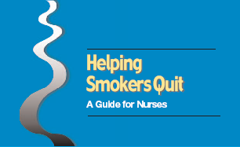
AHRQ Pocket Guide
Worked closely with our partner, Tobacco Free Nurses
Funded pocket guide for nurses, other professionals
http://www.ahrq.gov/clinic/tobacco/clinhlpsmksqt.htm

Slide 74
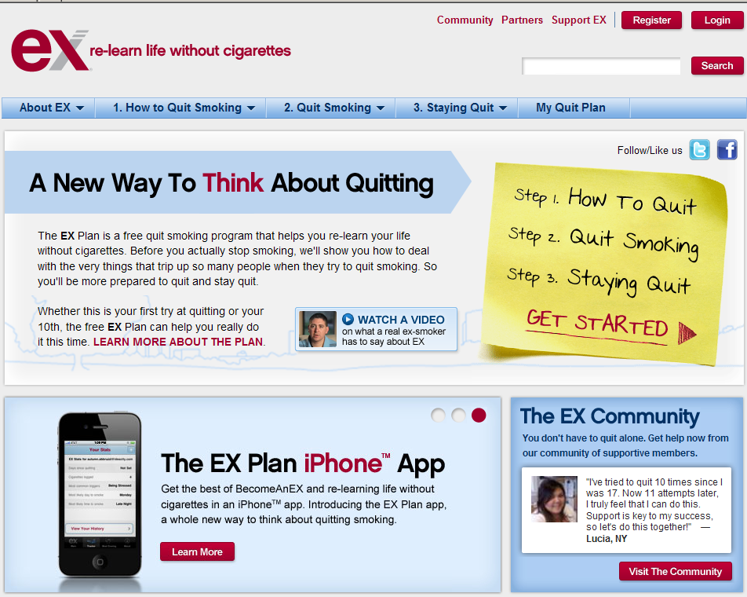
Online Smoking Cessation Assistance
Online smoking cessation services for smokers who prefer computers to phones
Anonymous, as with phone quitlines
Early studies show promising efficacy
  www.quitnet.com
  www.smokefree.gov
  www.becomeanex.org
www.becomeanex.org
Notes:
For patients who prefer computers to telephones, there are online services

Slide 75

Free Webinars
    Smoking Cessation 101
    Mental Health and Smoking Cessation
    Rx for Change: Assisting Mental Health Consumers with Tobacco Cessation Webinar Training
    Substance Abuse and Smoking Cessation
    Youth and Smoking Cessation
    Ask the Counselor
    Addressing Tobacco in Co-Occurring Conditions
    Destination Tobacco-Free Toolkit
    Building Staff Buy-In for Tobacco-Free Policies
    …24. UPCOMING: Practical Applications of the New Joint Commission Tobacco Standards – Opportunities for Tobacco Specialists and Hospital Administrators -- May 14, 2012, 1pm Eastern Time

Slide 76

SAMHSA 100 National Pioneers for Smoking Cessation Campaign
Incentivize 100 grantees with $1,000 honorarium
Participants incorporate smoking cessation activity
Free technical assistance to all 1500 grantees - Access to free resources, webinars
2 phases completed; some FQHCs
Replication in LA County

Slide 77
Networking Opportunities
Foster connection and communication
  100Pioneers@listsrv.ucsf.edu
Free, customized technical assistance
  877-509-3786
Sign up for Communiqué e-newsletter

Slide 78
What You Can Do Now
Refer 1-800-QUIT NOW
Encourage smoking cessation activities
Use available tools and curricula
Join SCLC webinars
Launch your own performance partnership

Slide 79
HHS is on board!
Dr. Howard Koh, Assistant Secretary for Health, convened HHS agency heads
HHS Tobacco Prevention and Control Working Group
Created subcommittees on Regulation, Surveillance, Prevention Policies, Education and Communication, and Cessation and Treatment
CDC $54 million national counter-marketing campaign, plus Million Hearts Campaign
FDA warning inserts, pending legal challenge
Notes:
Back to Steve for remaining slides

Slide 80
Tobacco Tipping Point?
California 11.9% adult smoking prevalence in 2010
National prevalence in 2010 at modern low—19.3 %!
Smokers smoke fewer cigarettes
Northern California Kaiser Permanente at 9%
Proliferation of smoke-free areas
Notes:
Steve

Slide 81
Tobacco Tipping Point (2)?
Physicians at 1% smoking prevalence
62 cent/pack federal tax increase 2009
Lung cancer deaths in women starting to fall
Increasing stigmatization of smoking
New FDA warning photos on cigarette packs
Joint Commission new regulations on smoking—smoking cessation one of 14 possible metrics, from which hospitals must pick 4
CDC’s $54 million ad campaign--2012
Regulation of nicotine content in cigarettes?
Notes:
Steve

Slide 82
Power of Intervention
⅓ to ½ of the 46.6 million smokers will die from the habit. Of the 31.1 million who want to quit, 10.3 to 15.5 million will die from smoking.
Increasing the 3% base line cessation rate to 10% would save 1 million additional lives.
If cessation rates rose to 15%, 1.5 million additional lives would be saved.
No other health intervention could make such a difference!
Notes:
Steve

Slide 83
Thank You
Steven A. Schroeder, MD
Director, Smoking Cessation Leadership Center
University of California, San Francisco
Reason S. Reyes, MPA
Director of Technical Assistance
Smoking Cessation Leadership Center, UCSF
rreyes@medicine.ucsf.edu
Smoking Cessation Leadership Center
1-877-509-3786 (toll free)
Resources available on website http://smokingcessationleadership.ucsf.edu

